Slide 1
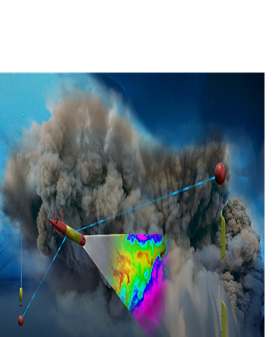


ADAC Year 6 Quarterly Review
ADAC Project Briefing
(LRAUV) for Under-Ice Mapping of Oil Spills and Environmental Hazards
PI/PM Amy Kukulya (WHO), PI Dr. Jim Bellingham (WHOI),
PI Brett Hobson (MBARI)

Slide 2
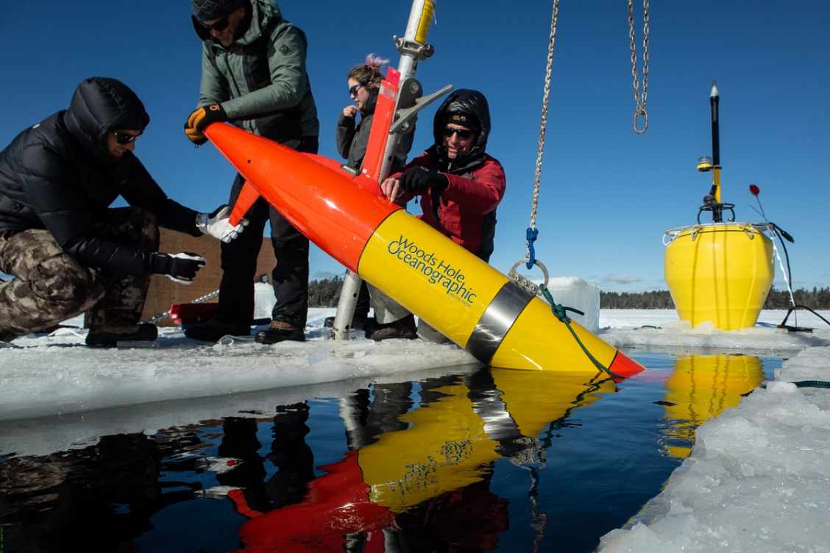
ADAC Project (LRAUV) for Under-Ice Mapping of Oil Spills and Environmental Hazards
ADAC Program Year 6 Annual Meeting 14 May 2020
Project Principal Investigator(s): PI Dr. Jim Bellingham (WHOI), PI/PM Amy Kukulya (WHOI), Co-PI Brett Hobson (MBARI)
Woods Hole Oceanographic Institution, Monterey Bay Aquarium Research Institute
Supporting Team: Daniel Gomez-Ibanez, Sean Whelan, Noa Yoder, Amanda Besaw, Brian Kieft, Ben Raanan
Project Champion: Kirsten Trego, HQ USCG MER
Project Advocates: Dr. Robyn Conmy, EPA USEPA/NRMRL/RTEB, USCG Research and Development Center, Dr. Jay Choy BSEE/Oil Spill Preparedness Division, Dr. Lisa Dipinto, NOAA, Office of Restoration and Response, Mr. Brian Dolph, USCG R&D Center

Slide 3
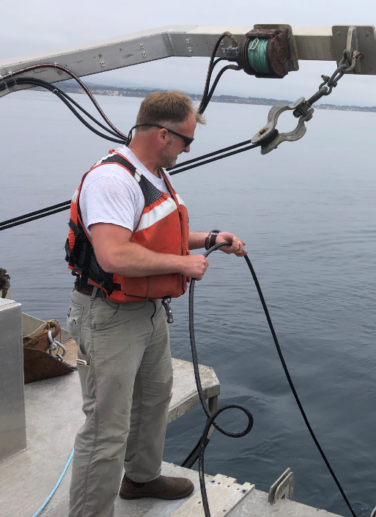
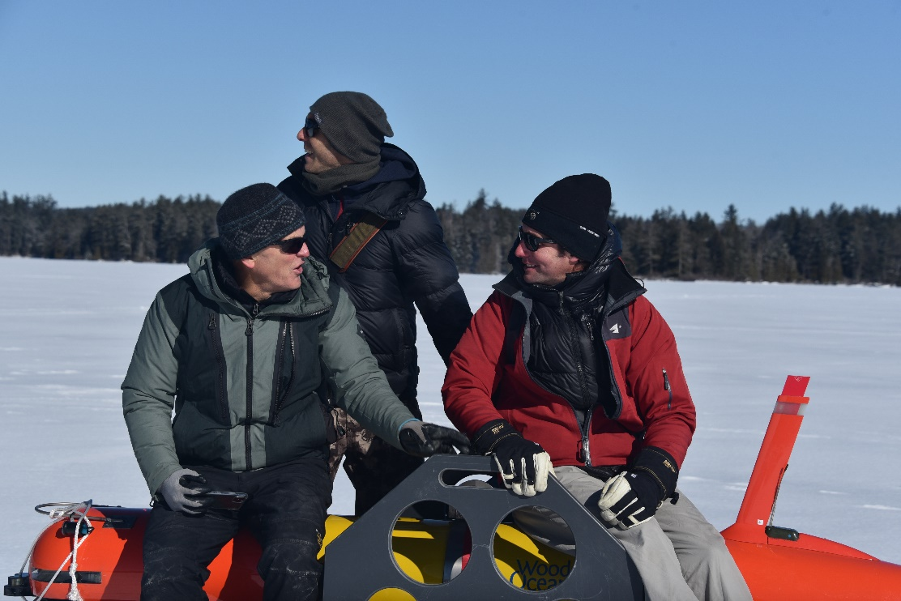
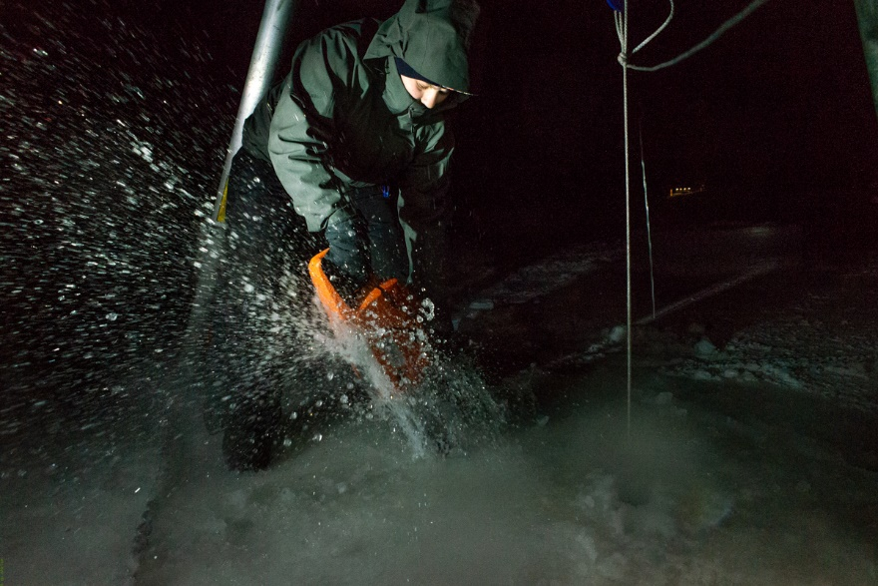
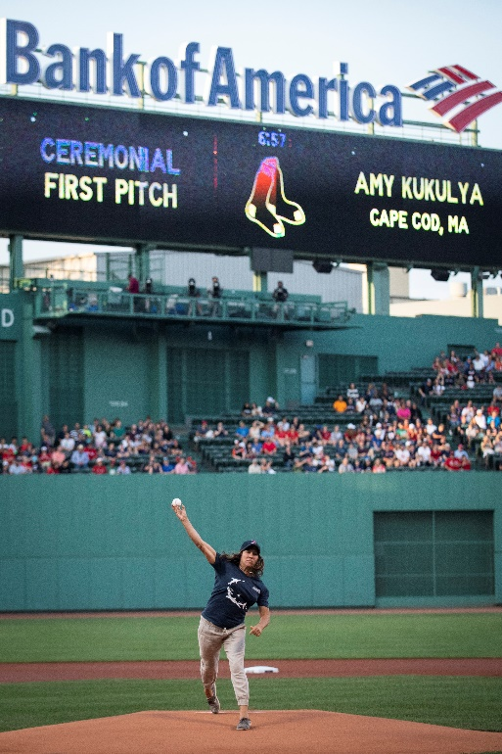
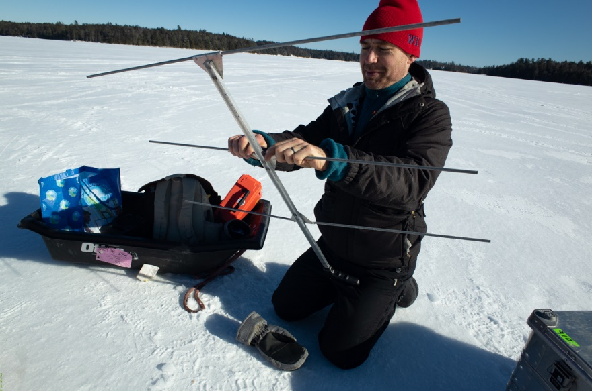
ADAC Program Year 6 Annual Meeting 14 May 2020
The WHOI-MBARI Operations/Engineering Team
Sean Whelan
Noa Yoder, WHOI
Daniel Gomez-Ibanez
MBARI’s Brett Hobson, Ben Raanan, Brian Kieft
Amy Kukulya
Not pictured: Amanda Besaw, Jim Bellingham

Slide 4
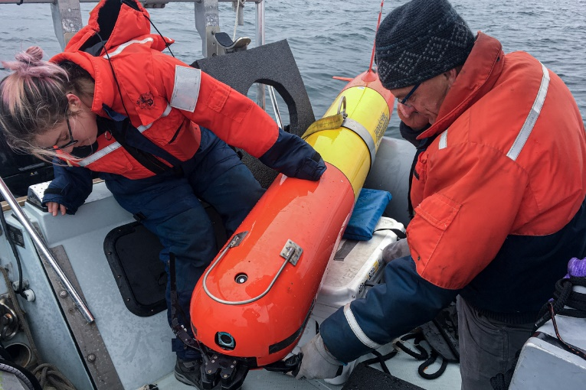
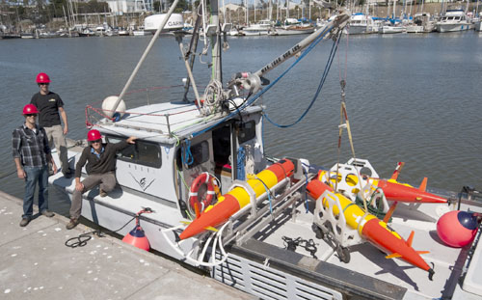
LRAUV: Description and Baseline
ADAC Program Year 6 Annual Meeting 14 May 2020
Baseline: Currently, there is no USCG baseline for an AUV to meet the unique demands of Arctic operations that requires a minimal logistical footprint, a small operational team and oil detection and mapping capability.
Project Description: To develop an Arctic-capable long-range Autonomous Underwater Vehicle (AUV) that is helicopter portable, carries an environmental mapping payload, allowing rapid response while providing situational awareness and damage mitigation for first responders/USCG.

Slide 5
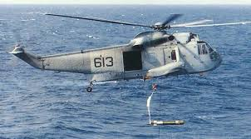
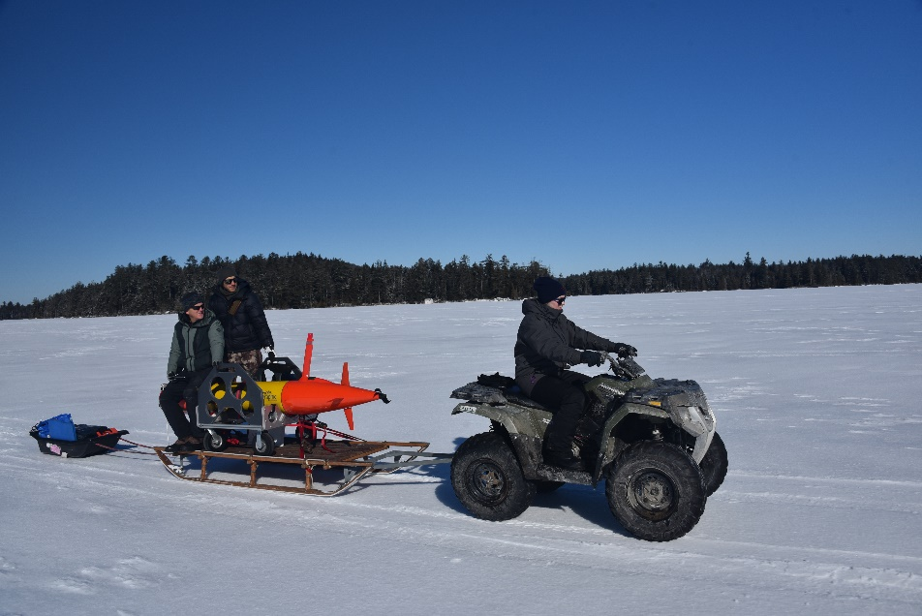
Project LRAUV: Relevance and Method
ADAC Program Year 6 Annual Meeting 14 May 2020
Relevance to DHS and USCG: We characterize the challenge as the ‘last seat in the helicopter’ problem: If first responders are operating at the far end of their logistical support capability, the system must be able to fill that void.
Research Method: Our approach is to leverage an existing Long-Range AUV developed at MBARI (LRAUV), and enhance the system to detect oil and operate under ice. LRAUV offers extended ranges (one to three weeks), and can be operated by a team remotely and monitored by anyone, anywhere.
We need an opportunity to deploy via a helo

Slide 6
ADAC Program Year 6 Annual Meeting 14 May 2020
The Vehicle: Tethys LRAUV
For under-ice dissolved hydrocarbon & environmental anomaly detection, mapping, and docking/undocking

Slide 7


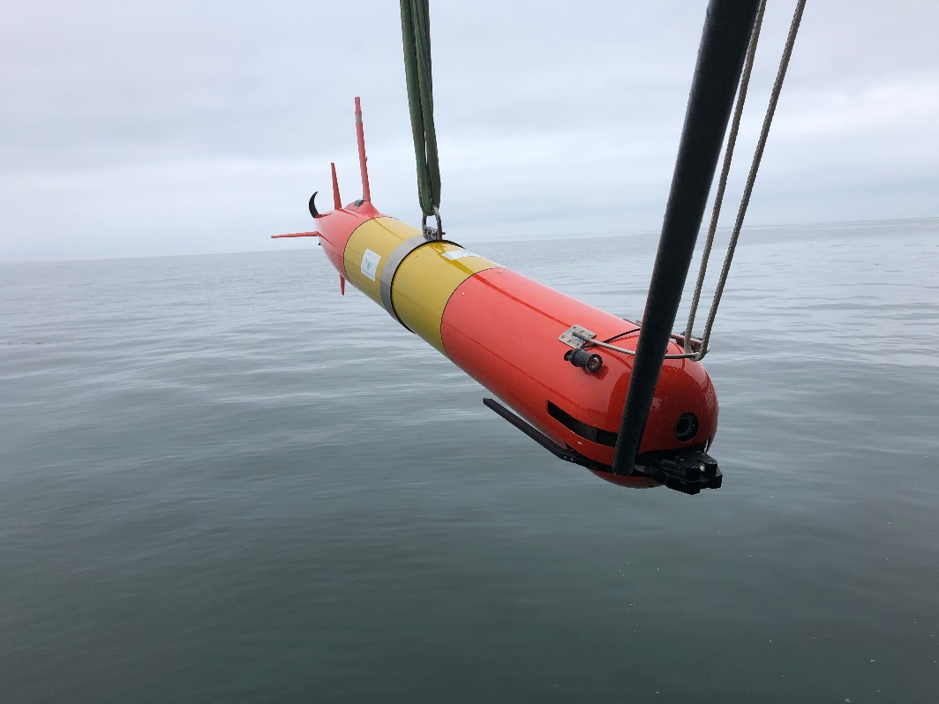
Long range autonomous capability: Tethys LRAUV
300-meter rated, 2.7 m long, 0.3 m (12’’) diameter, 110 kg dry weight.
Propeller-driven: 0.5~1.2 m/s speed. Buoyancy engine enables neutral buoyancy and drift mode.
Low-drag and low-power design: 15 day duration with 6 kWh rechargeable batteries, more than twice that with expendables.
Current Sensors: CTD, DO2, SeaOWL fluorescence/backscatter and hydrocarbon detection, Up/Down ADCP, umodem, USBL array, Docking nose, PAR
Notes:
2.3 standard to 2.7 docking

Slide 8
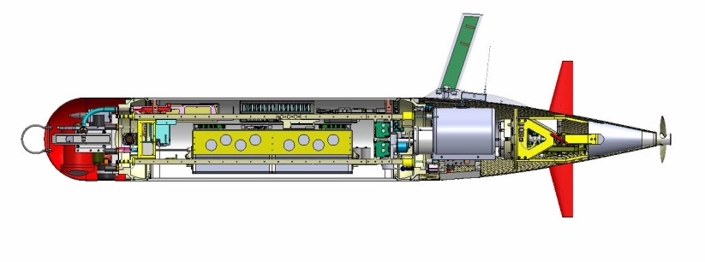
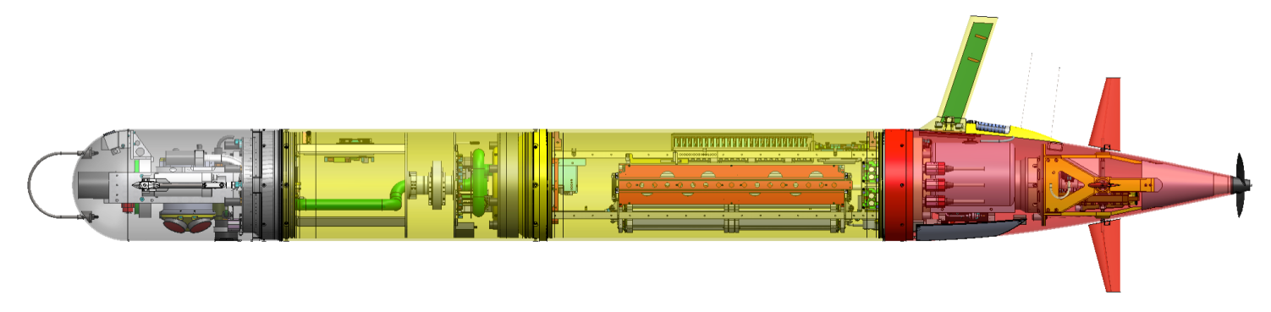
ADAC Program Year 6 Annual Meeting 14 May 2020
Tethys LRAUV Specifications
Core sensors: DVL/ADCP , Fluorometer/ Backscatter (WetLabs), CTD (Seabird), PAR, O2
Iridium, GPS, WiFi and Cellular in mast
Backup Argos and VHF
Load Control System
18 configurable channels
Isolates load, circuit breaker, ground fault detection
Buoyancy Engine allows neutral drift in water column - 1 Liter
Efficient low-speed propeller
------------------
Paired Rudder and Elevator Control Surfaces
3G ESP Sampler Module
6 kWh rechargeable,
11 kWh expendable
Shifting Mass allows controlled angle of attack during flight
Short Nose
With 3G ESP Nose
Mass: 110 kg ( 240lb) dry weight 160 kg (354 lbs)
Size: 0.3m (12”) diameter, 2.47m long 3.18 m long
Speed: 0.5 – 1.2 m/s plus hover 0.5 – 1.0 m/s plus hover
400 Ah energy, ~1.1 Ah/hr, 400 Ah energy, ~1.5 Ah/h ~3 km/hr .83 m/sec ~15 days, 1000 km ~2.5km/ hr ~11 days, 670 km

Slide 9
Why is LRAUV a smart choice?
ADAC Program Year 6 Annual Meeting 14 May 2020
Has a proven variable ballast system and mass shifter making it the only propeller-driven AUV in the world that can drift, hover and accurately navigate to tell you exactly where an anomaly is. (speed variability)
Buoyancy change and mass shifter allows vehicle to dive while stuck under-ice
Has reliably operated remotely for weeks at a time for more than ten years and can be operated from a web browser

Slide 10
Sensors
ADAC Program Year 6 Annual Meeting 14 May 2020
Up/down 600 kHz ADCP (RDI Pathfinders)- water velocities, relative terrain navigation
Licor Par for measuring photosynthetic artificial radiation (important for biological measurements when using an ecopuck)
SeaOwl Ecopuck-provides dissolved and droplet signals
Seabird CTD with a dissolved oxygen probe
WHOI Whisker Box for line capture docking
WHOI DUSBL for homing/docking
WHOI umodem for subsurface communication replaces need for LRAUV to surface to send data back to command control

Slide 11
ADAC Prgm YR7 Sensors to buy and or integrate
ADAC Program Year 6 Annual Meeting 14 May 2020
Soundtrap self-contained soundscape sensor
Inertial navigation
Multibeam for mapping
Multi-channel low frequency diversity array
Low-frequency receiver for low distance navigation (hundreds of kilometers
Chelsea UviLux- has a lower excitation (seaowl) wavelength, it gives you a clearer dissolved oil signal that can be discerned from natural humic DOM.
Notes:
UviLux sensors enable real-time, in situ detection of a wide variety of UV fluorescence parameters, including: Polycyclic Aromatic Hydrocarbons (PAH), BTEX, CDOM, Tryptophan-like fluorescence (TLF), BOD and Optical Brightening Agents (OBA). The compact and highly sensitive fluorometers have excellent turbidity rejection and high ambient light rejection, making them suitable for use in water and wastewater treatment works, as well as natural waters at the surface and to depths of up to 1000 m.
Find out more

Slide 12
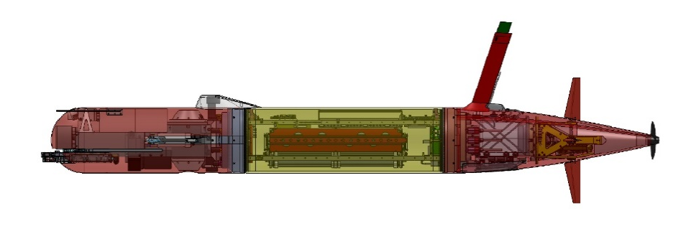
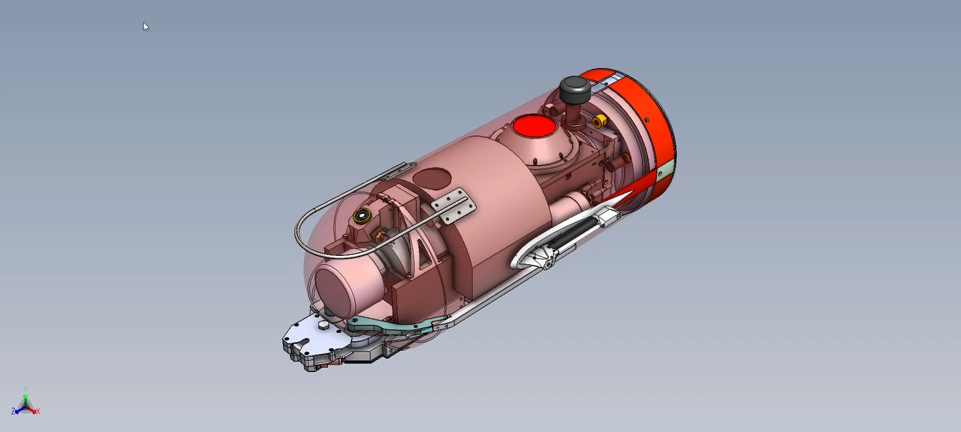
Polaris nose including multibeam

Slide 13
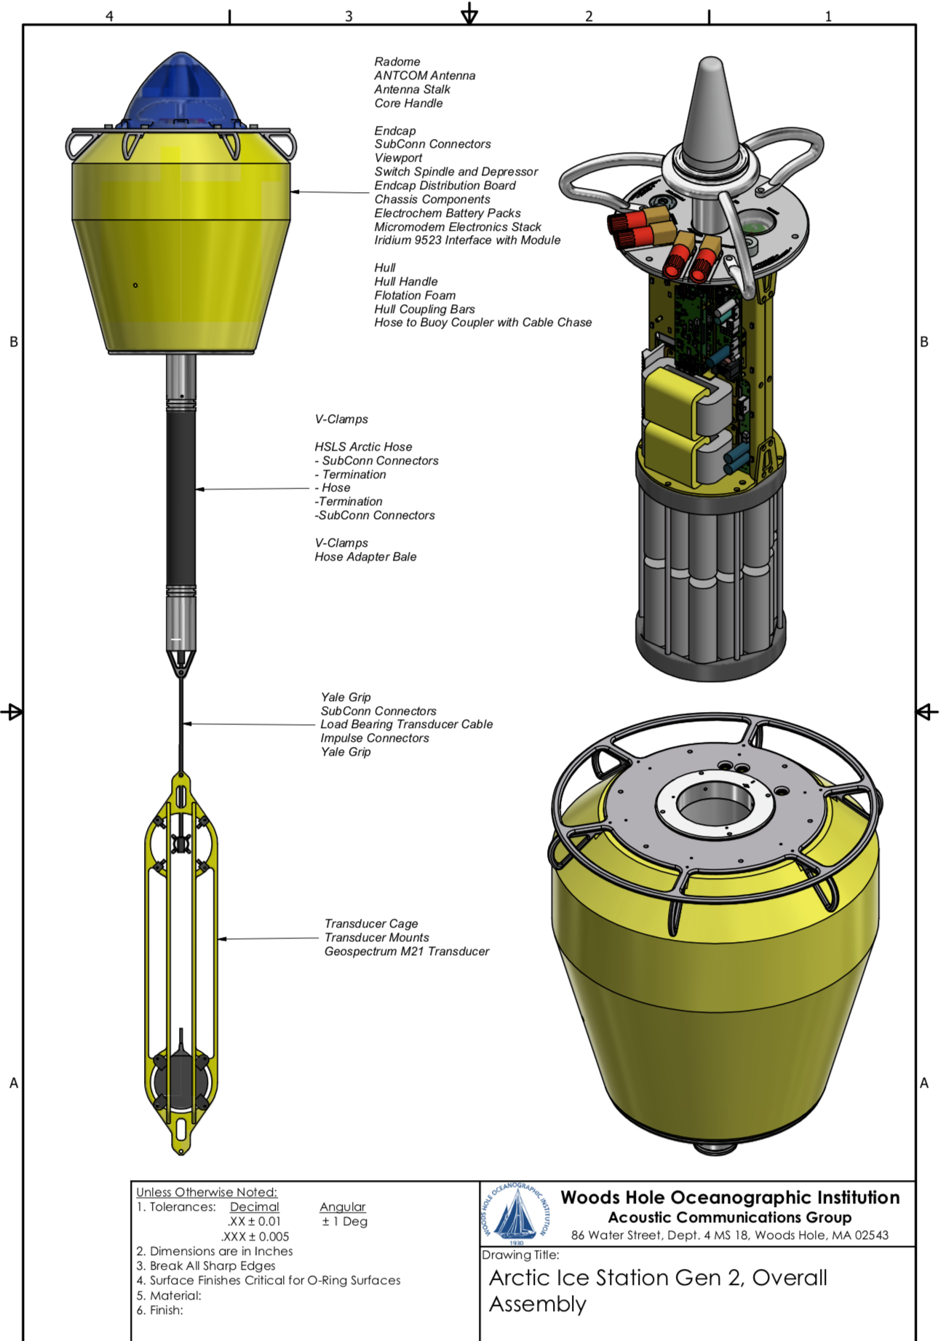
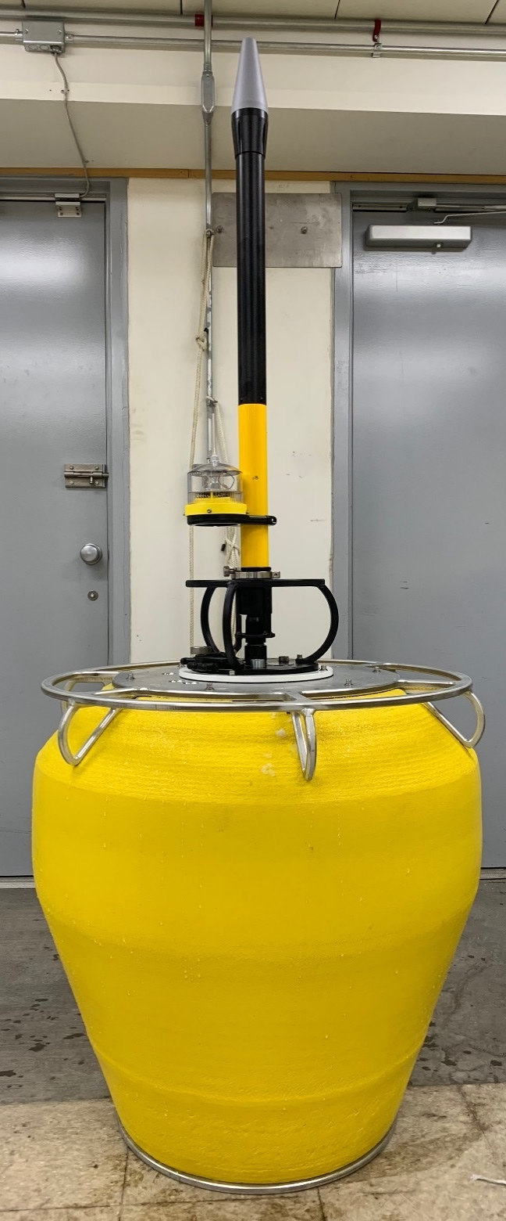
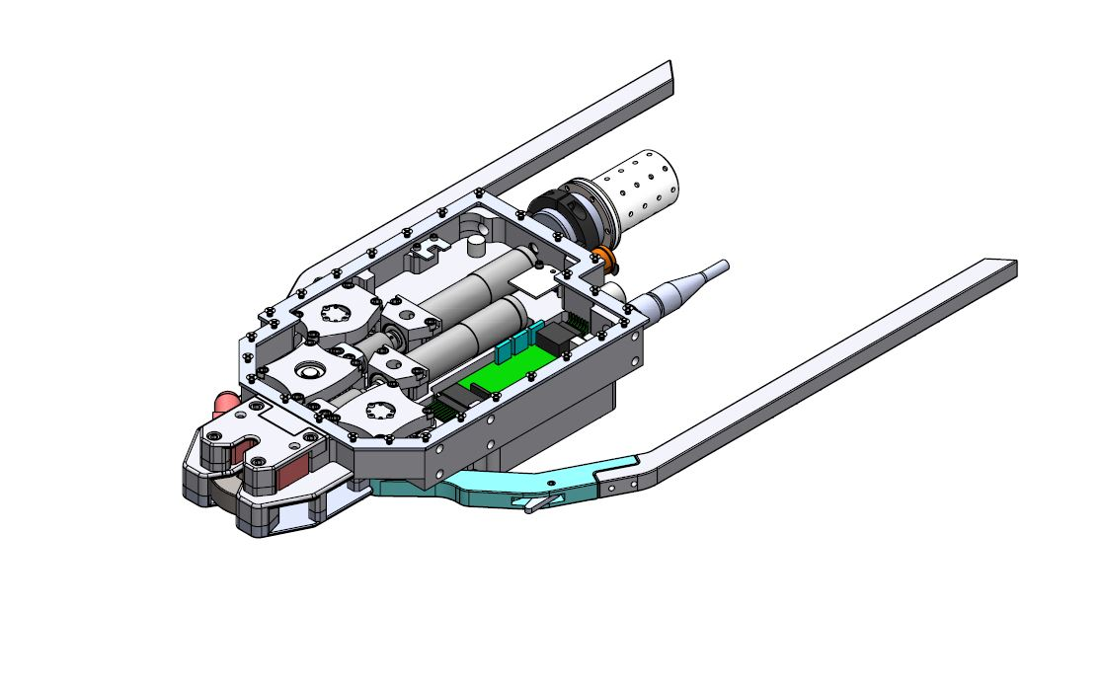
ADAC Program Year 6 Annual Meeting 14 May 2020
Arctic Buoy’s can be configured to be HF or LF
Acoustic range at LF 5 km and could exceed 10 km
Iridium, Freewave/RF, WIFI, cellular, flasher, USBL, LBL, Comms, docking target, expendable battery config
HF Buoys work best with the docking nose
Current testing is being down with a LF CUSBL array

Slide 14
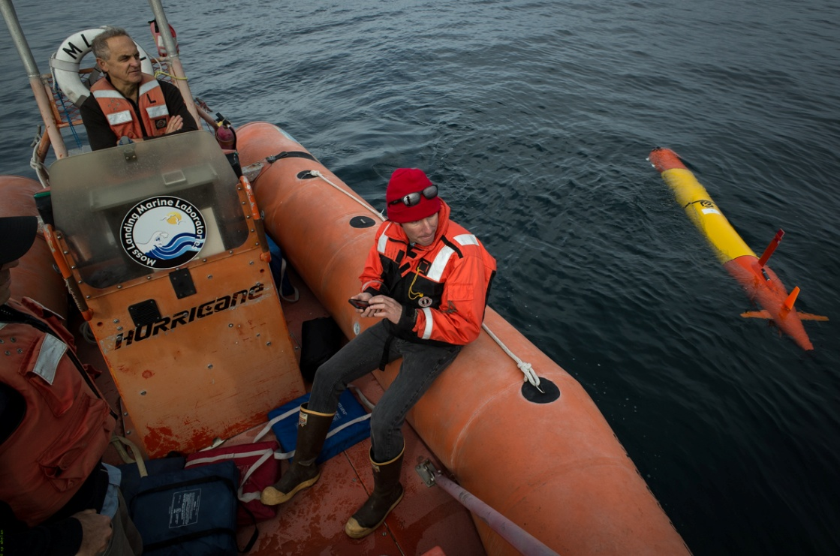
ADAC Program Year 6 Annual Meeting 14 May 2020
Remote Tracking
Notes:
Launched from a phone and operated from a phone from anywhere in the world.

Slide 15
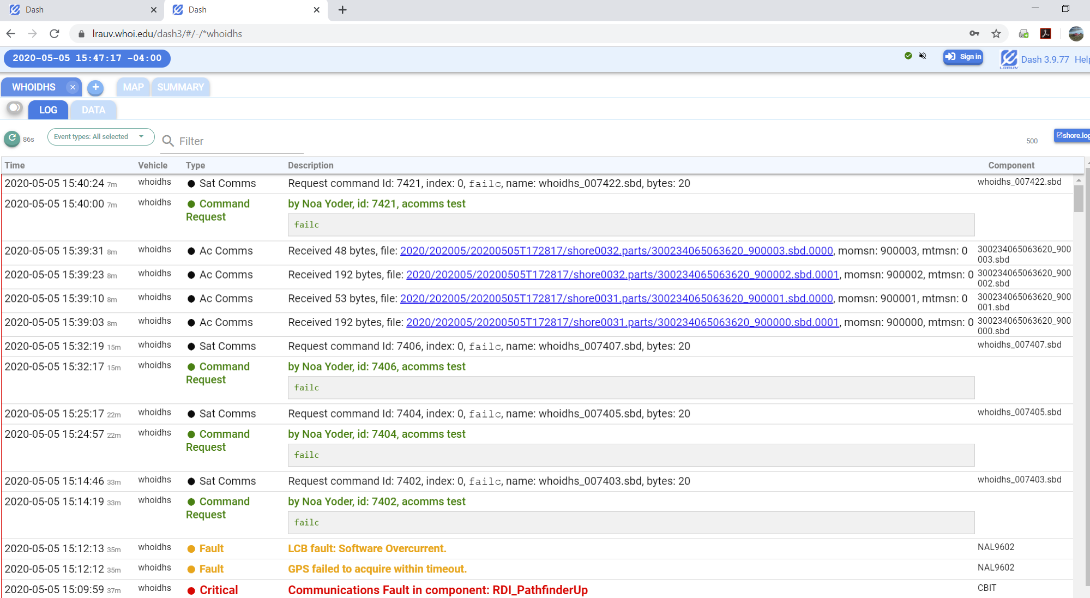
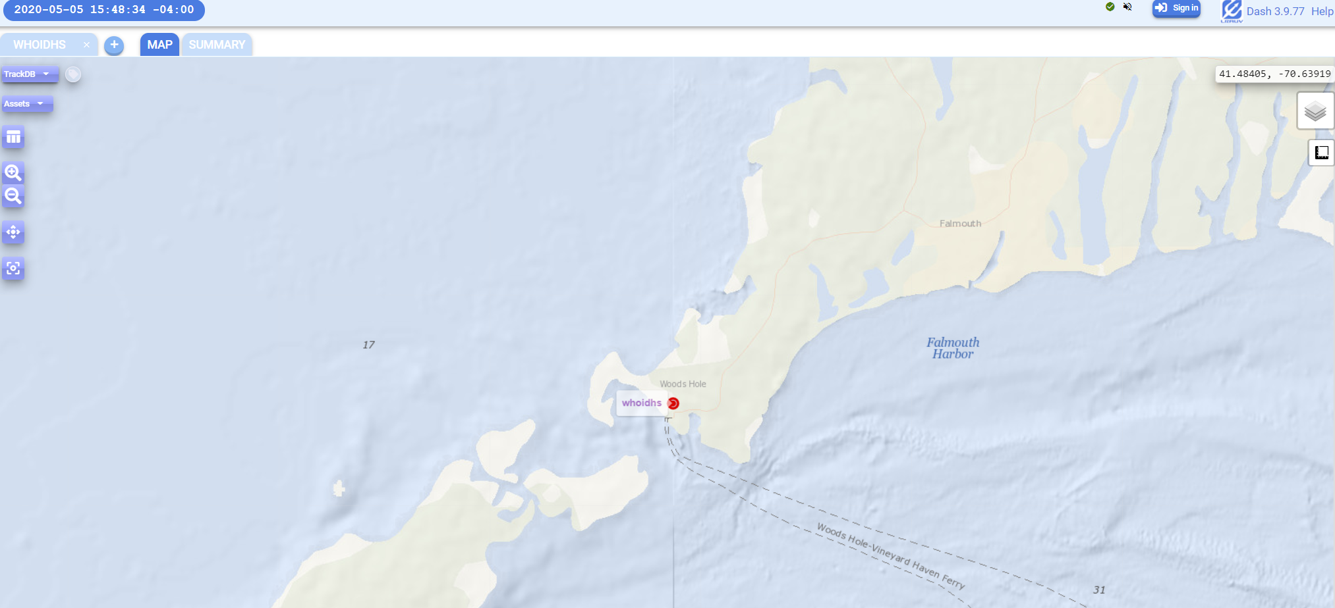
ADAC Program Year 6 Annual Meeting 14 May 2020
https://okeanids.mbari.org/dash3/#/-/whoidhs;Map
OR
https://lrauv.whoi.edu/dash3/#/-/whoidhs;Map
All LRAUV operations are conducted via remote communications
In YR6 WHOI installed a new Dash to host command and control on LRAUV platforms. This serves as a primary tracking system and/or complimentary Dash to MBARI’s tracking portal
Having 2 independent Dash setups allows for secure backup in case of technical difficulties inside WHOI or MBARI or for any reason operational control needs to be shifted from one institution to the next.
Typically operators use an Ipad to run the vehicle, but cell phone, etc. also work

Slide 16
ADAC Program Year 6 Annual Meeting 14 May 2020
Current Year Schedule, Status and
Accomplishments

Slide 17
Project LRAUV Key Milestones Achieved (1 of 4):
ADAC Program Year 6 Annual Meeting 14 May 2020
The team conducted a review of the LRAUV mechanical build and is currently completing a review of electrical systems for updates and improvements with an emphasis on performance and cost savings. The team reviewed design materials and acquisition of materials in accordance with revalidated LRAUV bill of materials.
The team achieved successful underwater docking and undocking to a transponder and to the Arctic buoys.
The team developed an add on- second dock capability (open-water testing pending) (WHOI/MBARI)
The team conducted a rapid response oil exercise/expedition at Santa Barbara Seeps in conjunction with the USCG, NOAA and EPA (August, 2019)
We evaluated docking statistics and we built HF-LF conversion kits and modified all three buoys for optimal docking and have a kit to change buoys frequencies between high and low depending on mission objectives
MBARI performed offshore testing of vehicle docking and under-ice behaviors; and shipped Polaris Jan 25 2020 to WHOI
Conducted training and open-water testing, remote simulation of under-ice operations in Woods Hole
Developed firmware for buoys for subsurface capabilities (USBL, ACOMMS)

Slide 18
ADAC Program Year 6 Annual Meeting 14 May 2020
Project LRAUV Key Milestones Achieved (2 of 4):
Conducted further evaluation COTS sensor packages (split beam, multibeam, methane, optics); (WHOI, ongoing) Purchased new sensors
Developed PDM tools and procedures for LRAUV Build-2 using Vault and WHOI Roundabout. Released all mechanical drawings except those identified to be candidates for low cost manufacturing
Evaluated end of life parts and LRAUV system for improvements and manufacturing. Internal battery charger system will be redesigned to be more efficient and will also increase battery capacity.
Transition meeting with RDC, MBARI, ADAC leadership (CMR Annual Meeting, Woods Hole, September 24-25 2019)
Planned logistics for and conducted New England under-ice test in a frozen lake in Maine conducted between 6-12 Feb 2020- First ever under-ice dynamic docking of an AUV!
Presented work at Oceans 2020, February 2020, San Diego
Planned logistics for under-ice testing of Polaris in Lake Superior in late March (dates pending at 20 march- 3 Apr) hosted by the Great Lakes Research Center Postponed until 2021

Slide 19
ADAC Program Year 6 Annual Meeting 14 May 2020
Project LRAUV Key Milestones Achieved (3 of 4):
Developed WHOI operational DASH for operating LRAUV from inside WHOI https://lrauv.whoi.edu/
21 assemblies were reviewed per low-cost evaluation, i.e. decision to 3D print, etc.
Participated in a Tabletop exercise in North Slope (27 Feb – 3 March)
Planning (to include joint planning for an Arctic region testing regime for summer 2020). Now postponed
Sonar payload evaluation and nose design and Payload nose config changes (June 30, 2020)
Develop LBL and test in Buzzards Bay, June 2020

Slide 20
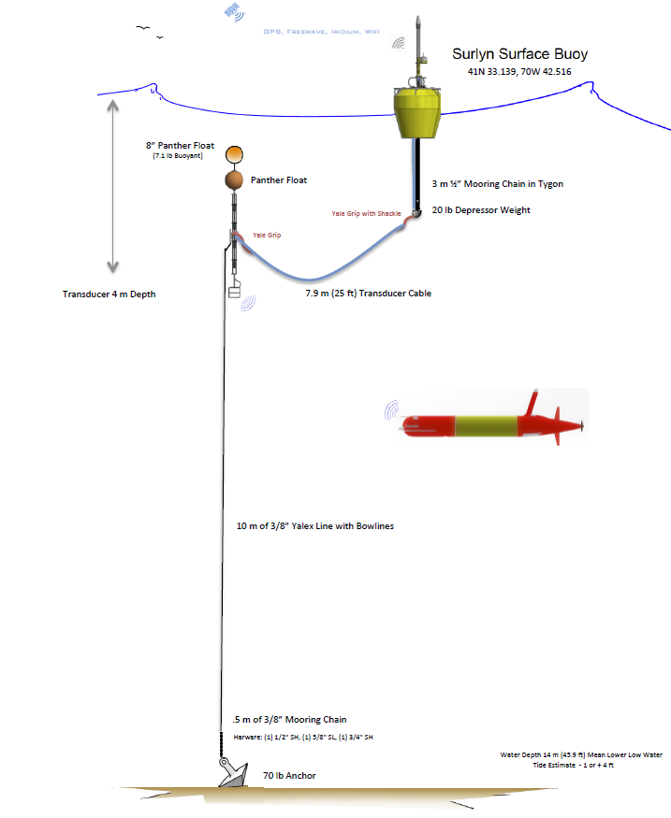
ADAC Program Year 6 Annual Meeting 14 May 2020
Project LRAUV Key Milestones Achieved (4 of 4):
Holding Redesign reviews of LRAUV communications antenna, needs to be more rigid for under-ice operations (broke two)
Developed new software behavior missions for docking, undocking, no surfacing, new sensor configurations, refinement of plume tracking for oil mapping
Develop LARS capabilities
  Designed and will be implementing a davit on the WHOI R/V Hurricane
  Vehicle can be picked from the nose or with a center bail when installed
Developed Arctic buoy moorings for open ocean operations

Slide 21
ADAC Program Year 6 Annual Meeting 14 May 2020
Key Milestones remaining:
Project team will initiate subcomponent assembly and fabrication of LRAUV (to be concluded in Program Year 7). Project team will conclude approximately 50 percent of fabrication by 30 June. Delayed
Complete testing of long-base-line navigation for LRAUV to be able to map the seafloor with sonar/cameras (June 30, 2020)
Prepare for Barrow Summer Tests, Paused
Two more transition meetings remain with USCG RDC
Prepare shipment to Barrow for Summer 2020 operations, Postponed
Procure sonar and integrate payload
  Designs evaluated for low power multibeams, pending purchase

Slide 22
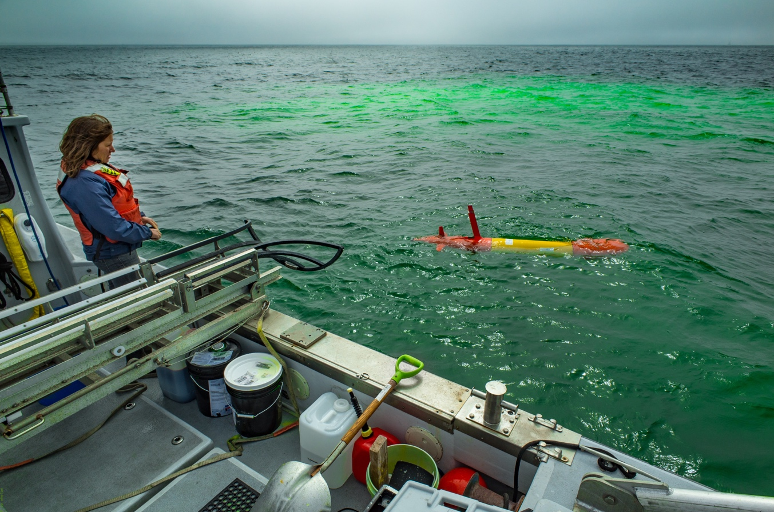
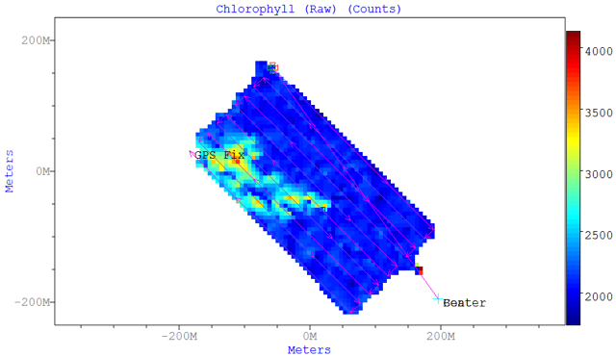
Project LRAUV: Scientific Metrics
ADAC Program Year 6 Annual Meeting 14 May 2020
Ongoing metrics:
  Ability to map environment in 3D;
  Detection and quantification of dissolved particles;
  Determine the physical ocean environment (and determine acute/critical variables, such as assessing hypoxia of the water column in/near spill area);
  Take CTD measurements;
  Simulator fidelity for development, mission testing, and operator training.
  LRAUV will be able to line capture or dock to a fixed beacon with its USBL and capture nose assembly. Target=50% success
  Get LRAUV data into the NOAA ERMA and DIVER pipeline
Heat Maps from Sea Owl

Slide 23
ADAC Program Year 6 Annual Meeting 14 May 2020
June & August 2019
Field Operations: Santa Barbara Seeps

Slide 24

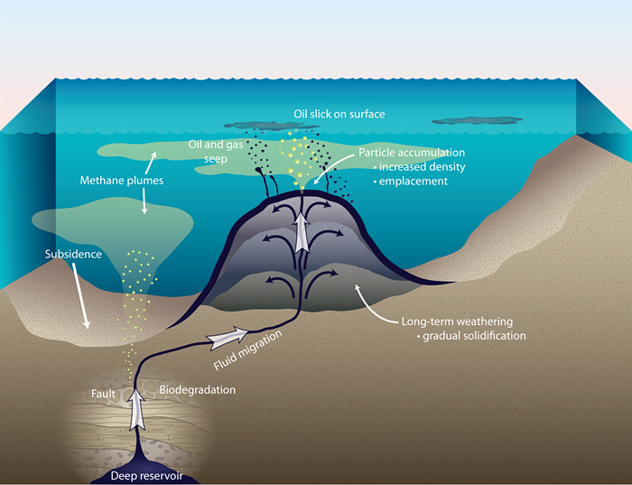
ADAC Program Year 6 Annual Meeting 14 May 2020
Santa Barbara Oil Tests June and August 2019
Extensive faulting or rupturing in the Earth allows oil and gas from subterranean reservoirs to seep up to the seafloor and ultimately into the ocean and to the atmosphere. (WHOI)
Oil and methane bubbles surface at Coal Oil Point, near Santa Barbara, (D. Valentine, UCSB (WHOI Oceanus Mag)

Slide 25
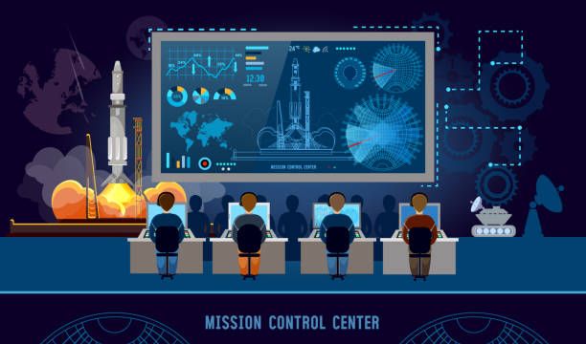
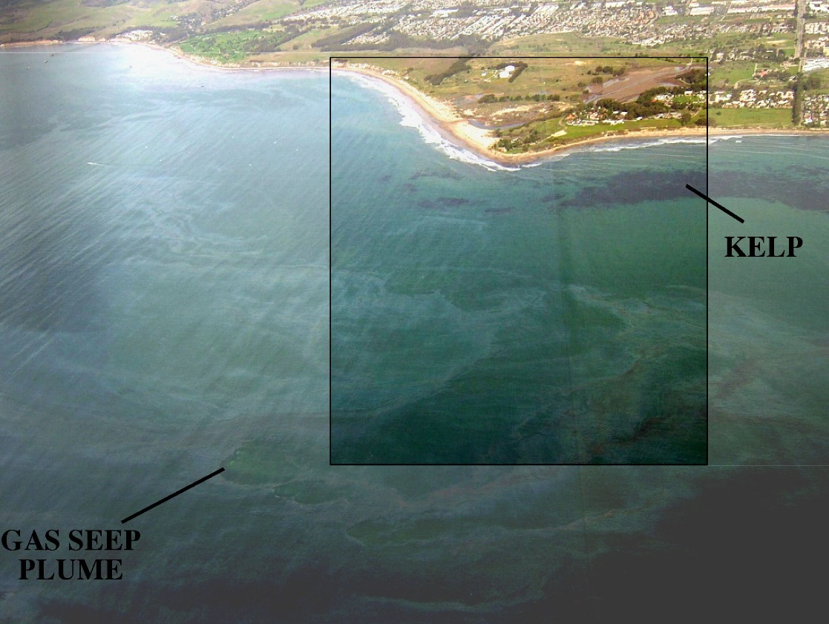
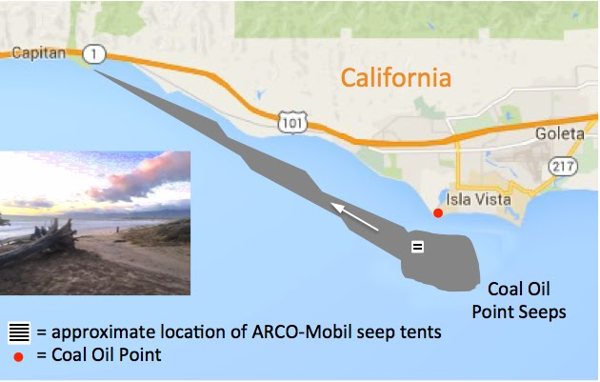
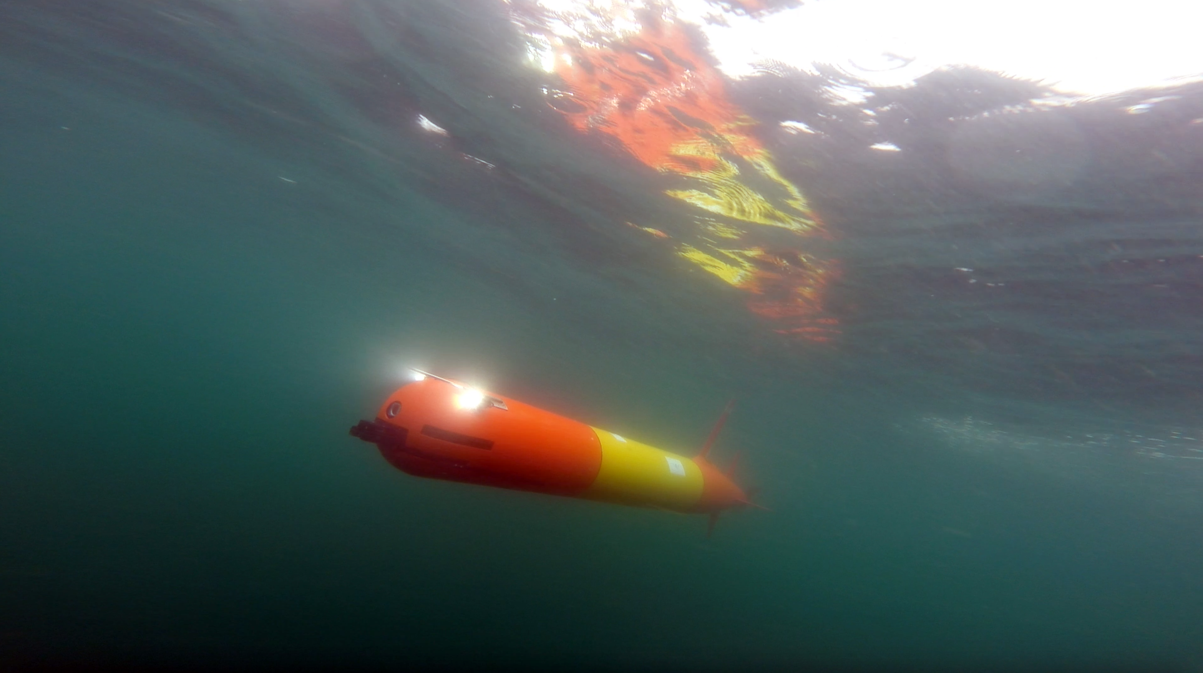



ADAC Program Year 6 Annual Meeting 14 May 2020
Santa Barbara LRAUV Surveys
Command Control
Coal Point

Slide 26
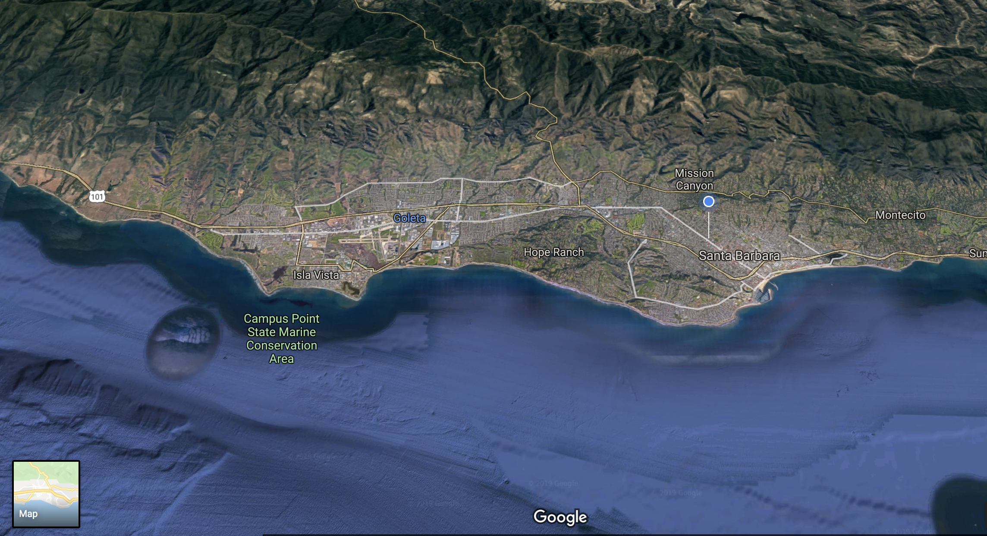
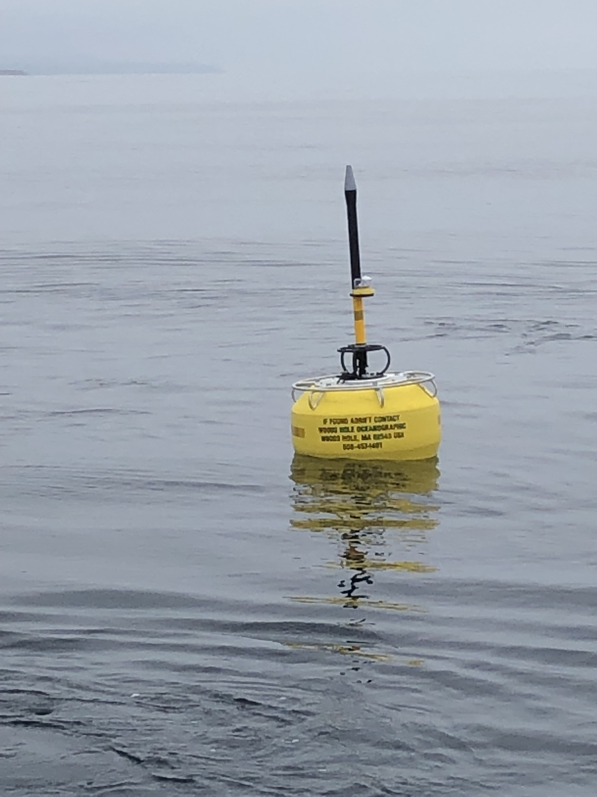
ADAC Program Year 6 Annual Meeting 14 May 2020
REMOTE COMMS Success with Buoy!
Same functionality for Arctic!
Key objectives:
Remote Comms LRAUV to
RF Antenna at UCSB
To Laptop at house (blue dot) email server at MBARI
Sends email to WHOI
Forwards back to MBARI to display (decode) on Dash
30 second round trip
Reliable 5 km range or line of site
ACOMMS
No Surfacing
Test detection of oil with SeaOWL
Test Patch tracking algorithm
11 miles
UCSB location of Freewave antenna

Slide 27
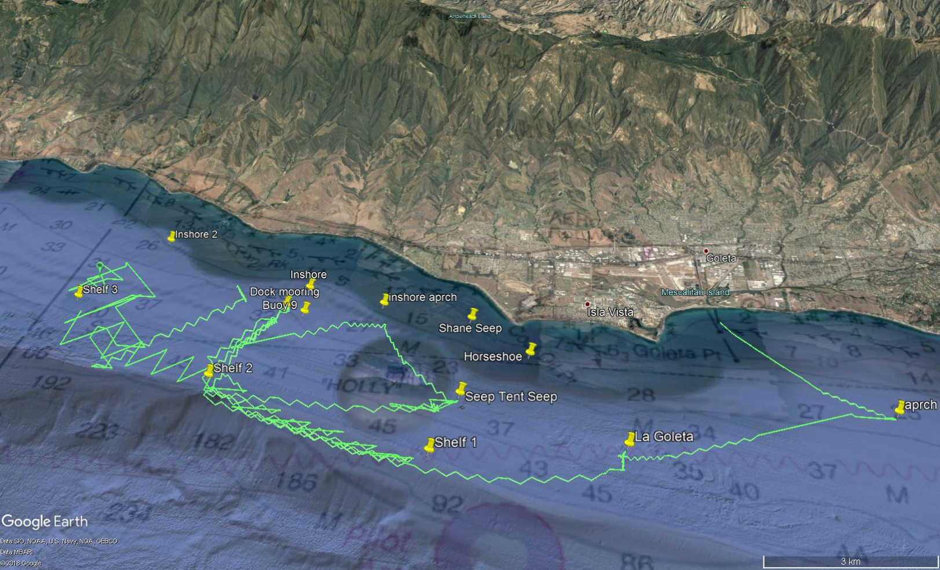
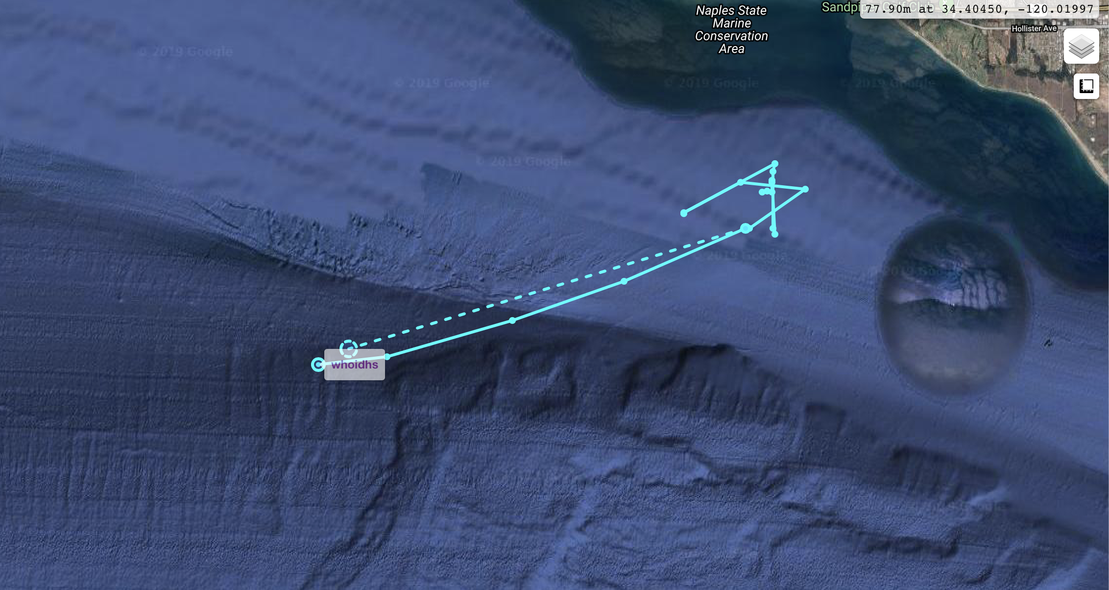
Santa Barbara Seeps Testing
Received input from Dave Valentine UCSB about an unmapped seep off the shelf in 240 meters of water. Redirected LRAUV to sample hours later.

Slide 28
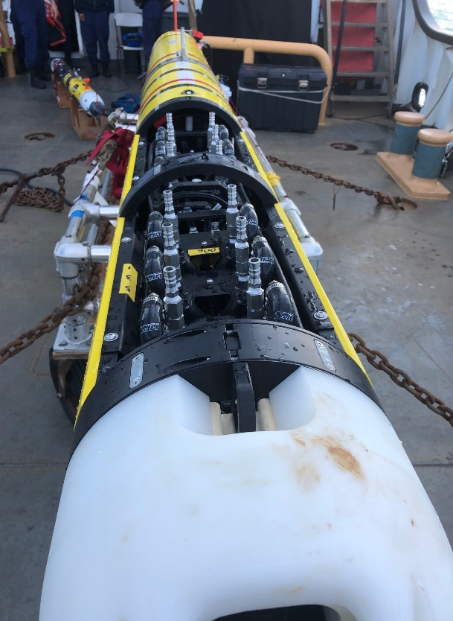



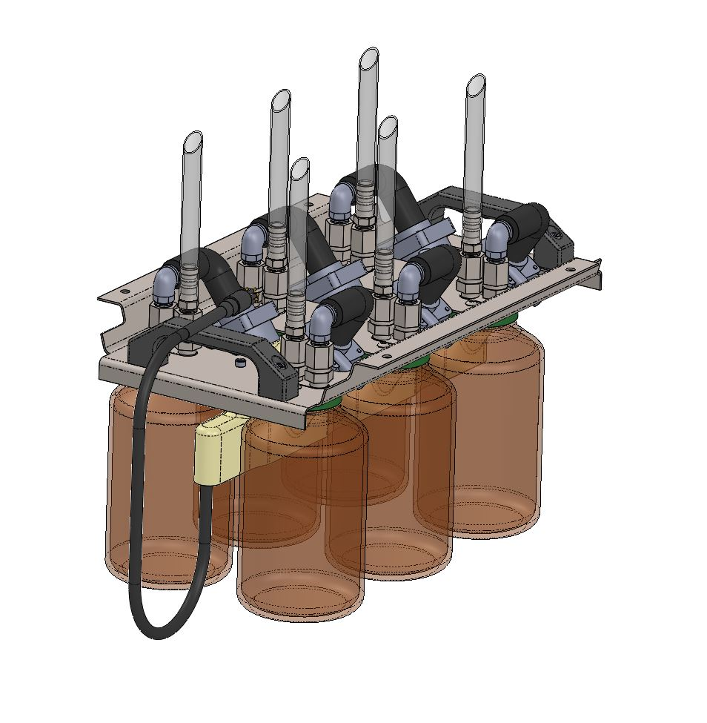
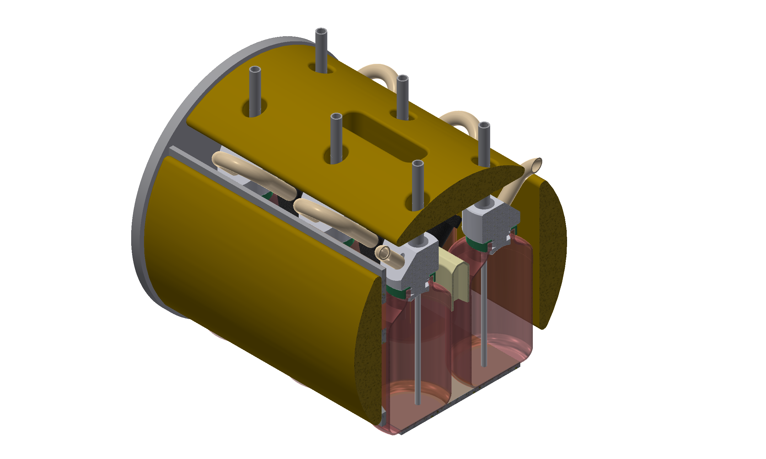
ADAC Program Year 6 Annual Meeting 14 May 2020
Project LRAUV: Complimentary Work
Innovation for 3D Characterization of Oil Spills:
Project: 3D mapping and characterization of oil droplets using a REMUS-600 with oil sensing/sampling sensor package:
Development of a water gulper (sampler) for collecting water samples up to one liter per bottle (12 per dive)
SeaOWL ecopuck will determine where to sample
Also includes, HD camera, DO, CTD and sidescan sensors
Integration of a holographic camera miniaturized based on the same system used at DWH
  *Field testing at Santa Barbara Seeps site by August 2019
6 -1L bottles per section, allows for 12 samples per dive
Water Gulper Development
Notes:
Needs logos EPA, NOAA, BSEE, UNH

Slide 29
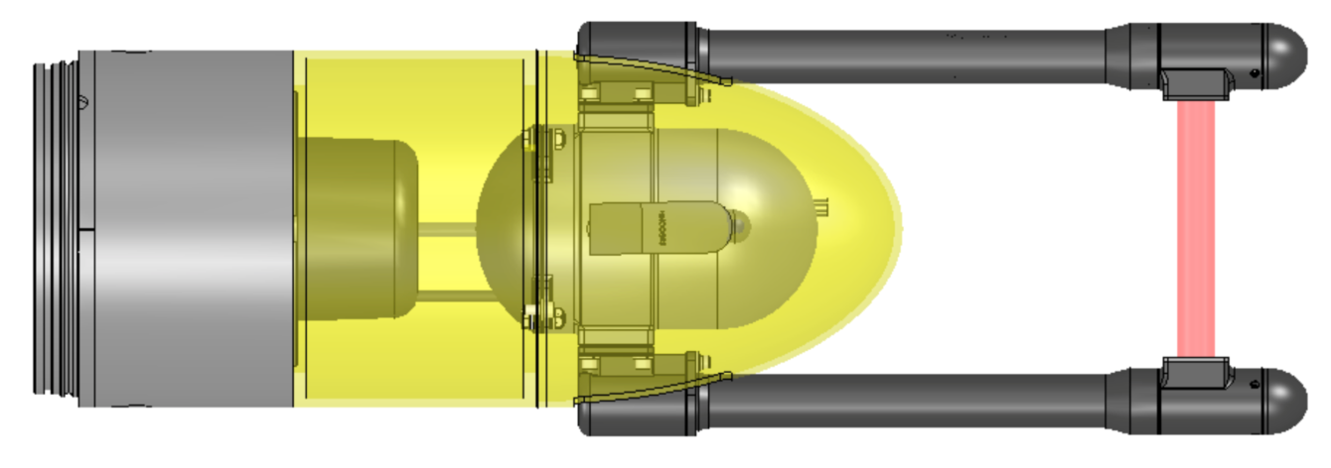
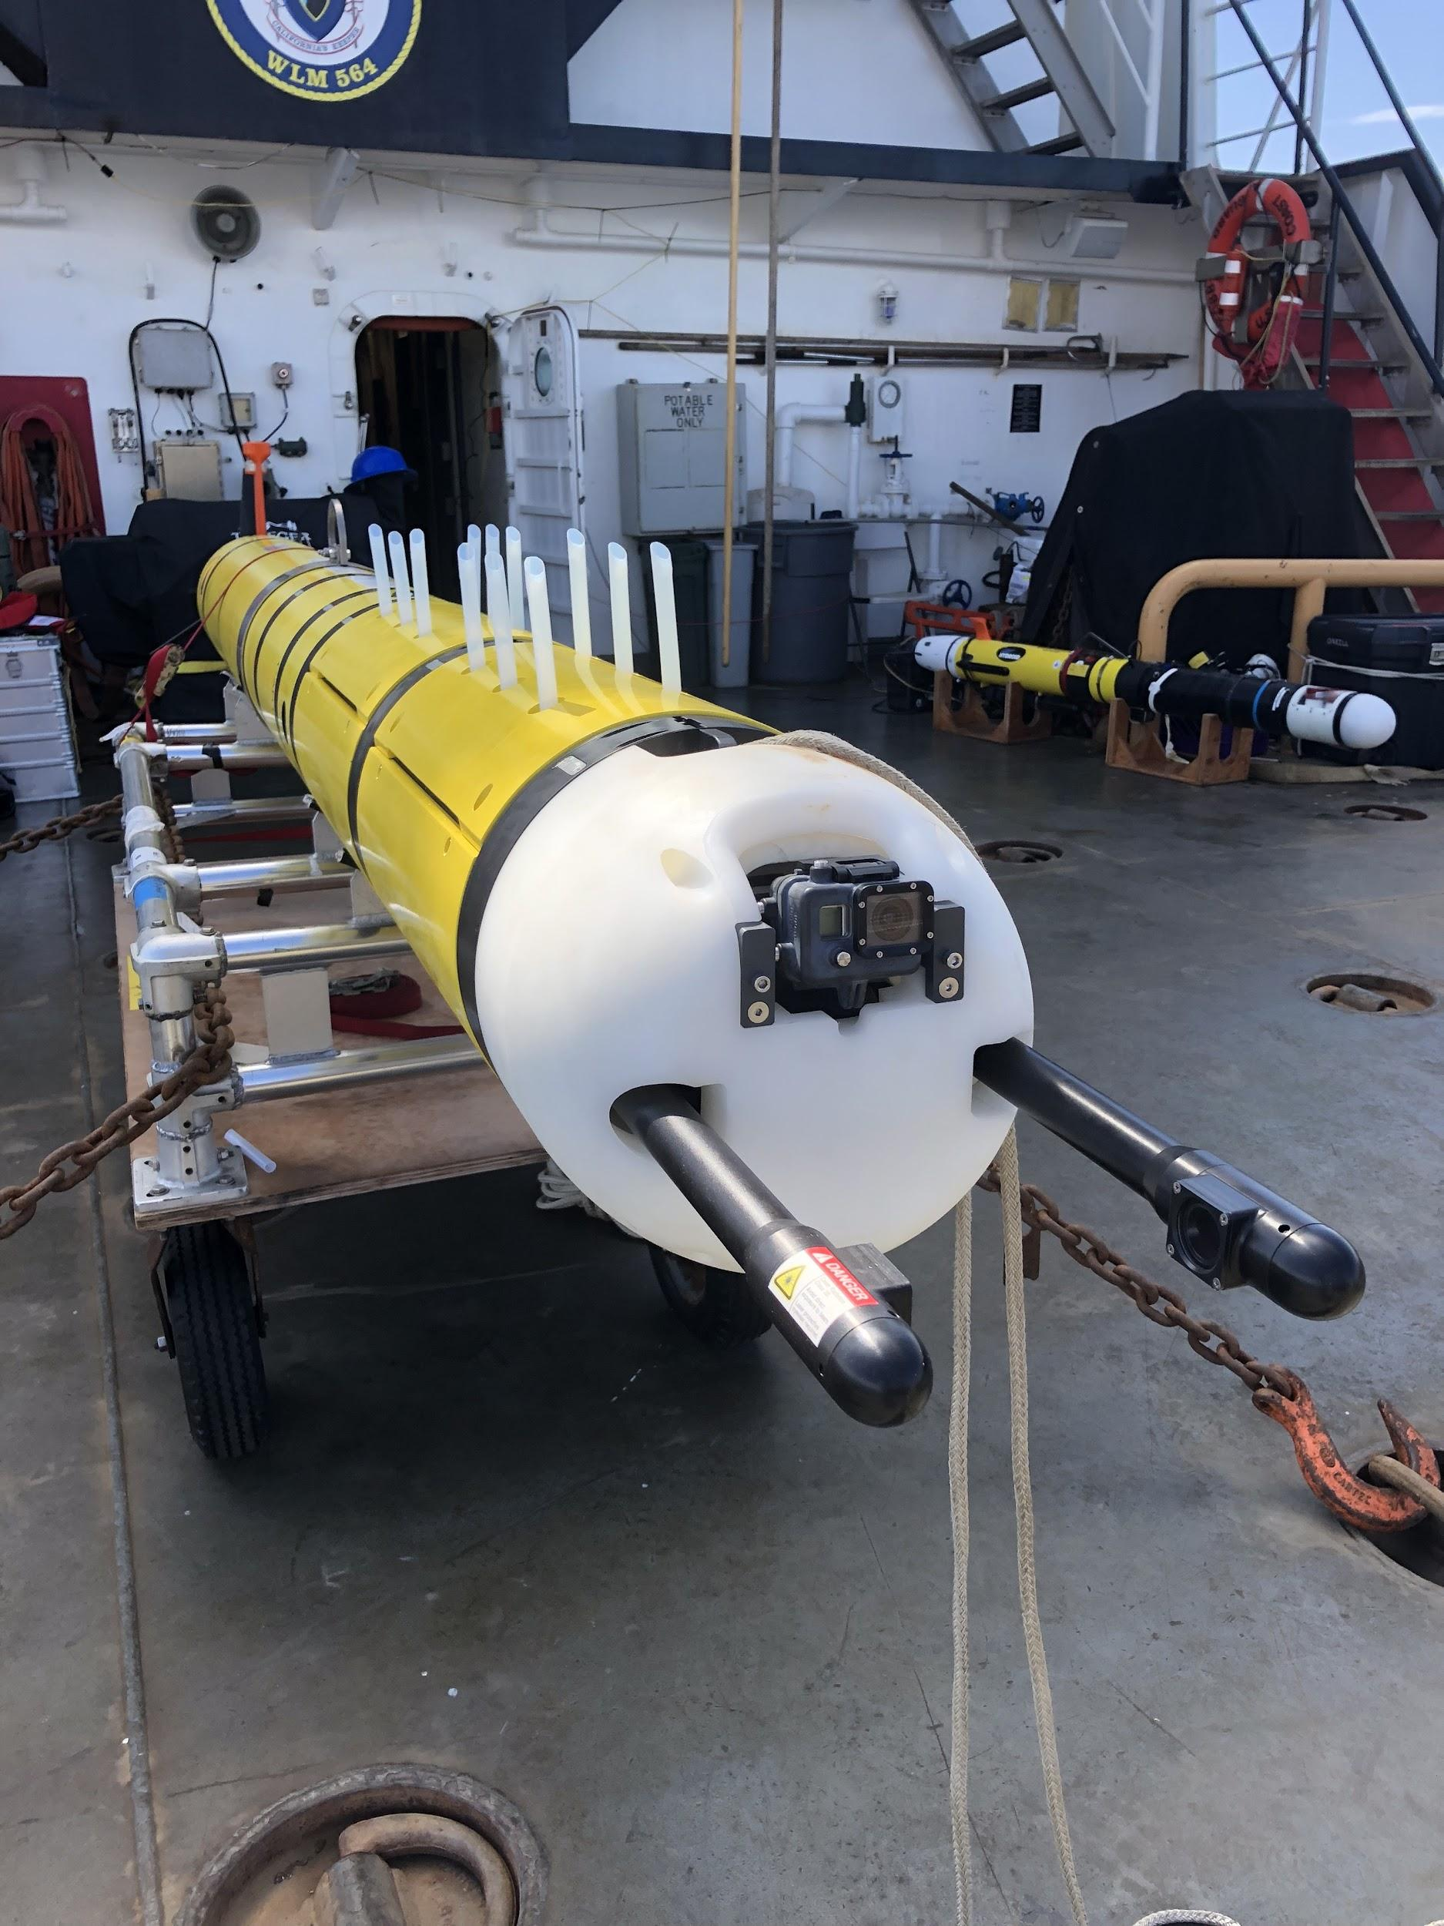
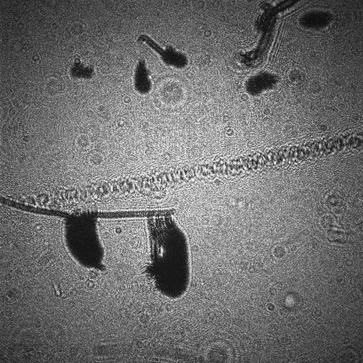
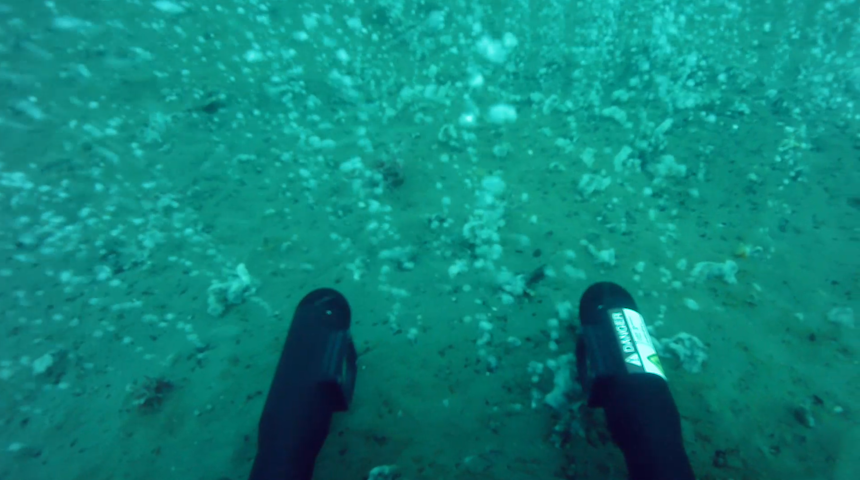
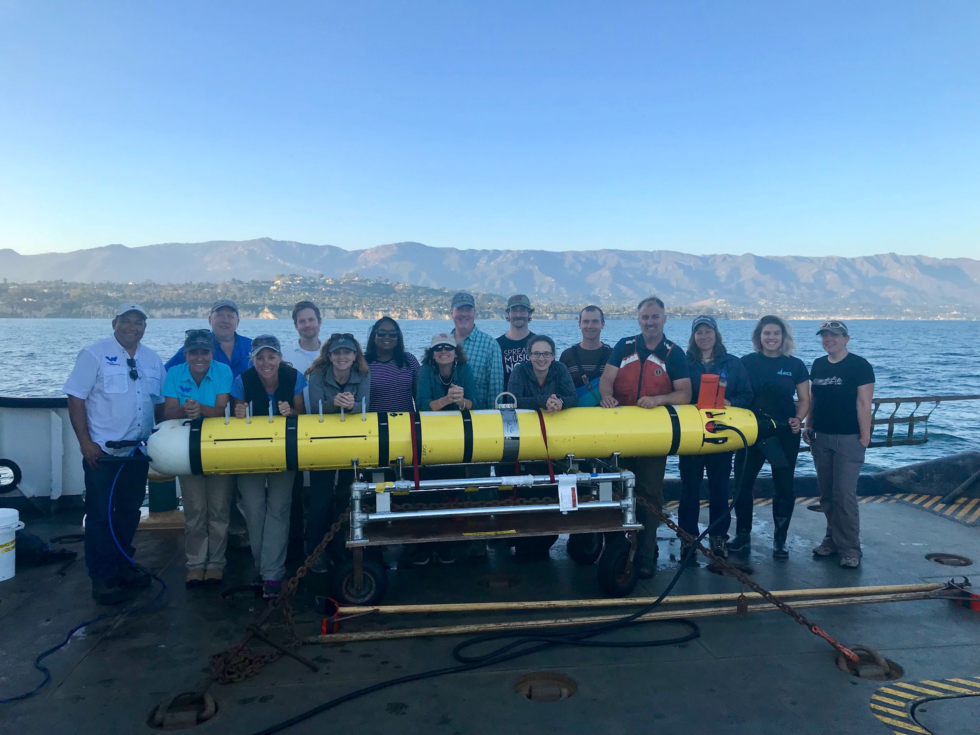
ADAC Program Year 6 Annual Meeting 14 May 2020
Innovation for 3D Characterization of Oil Spills: Holocam
Based on system used by C. Davis during DWH and miniaturized to fit smaller vehicles like REMUS-100 (7.5 inches in diameter)
Imagining volume of 20 ml can give you 318 images in one holographic image- huge amount of data
System rated to 1000 meters and can be used on other platforms, just need power and Ethernet
Notes:
Rated to 1000 meters, length of image volume=15.9 cm, imaging volume 20 ml, max imaging rate 10 Hz, image size 4.09 mb png, 2 tb storage, 13.5 hrs to fill drive, 10 hours to data transfer.

Slide 30
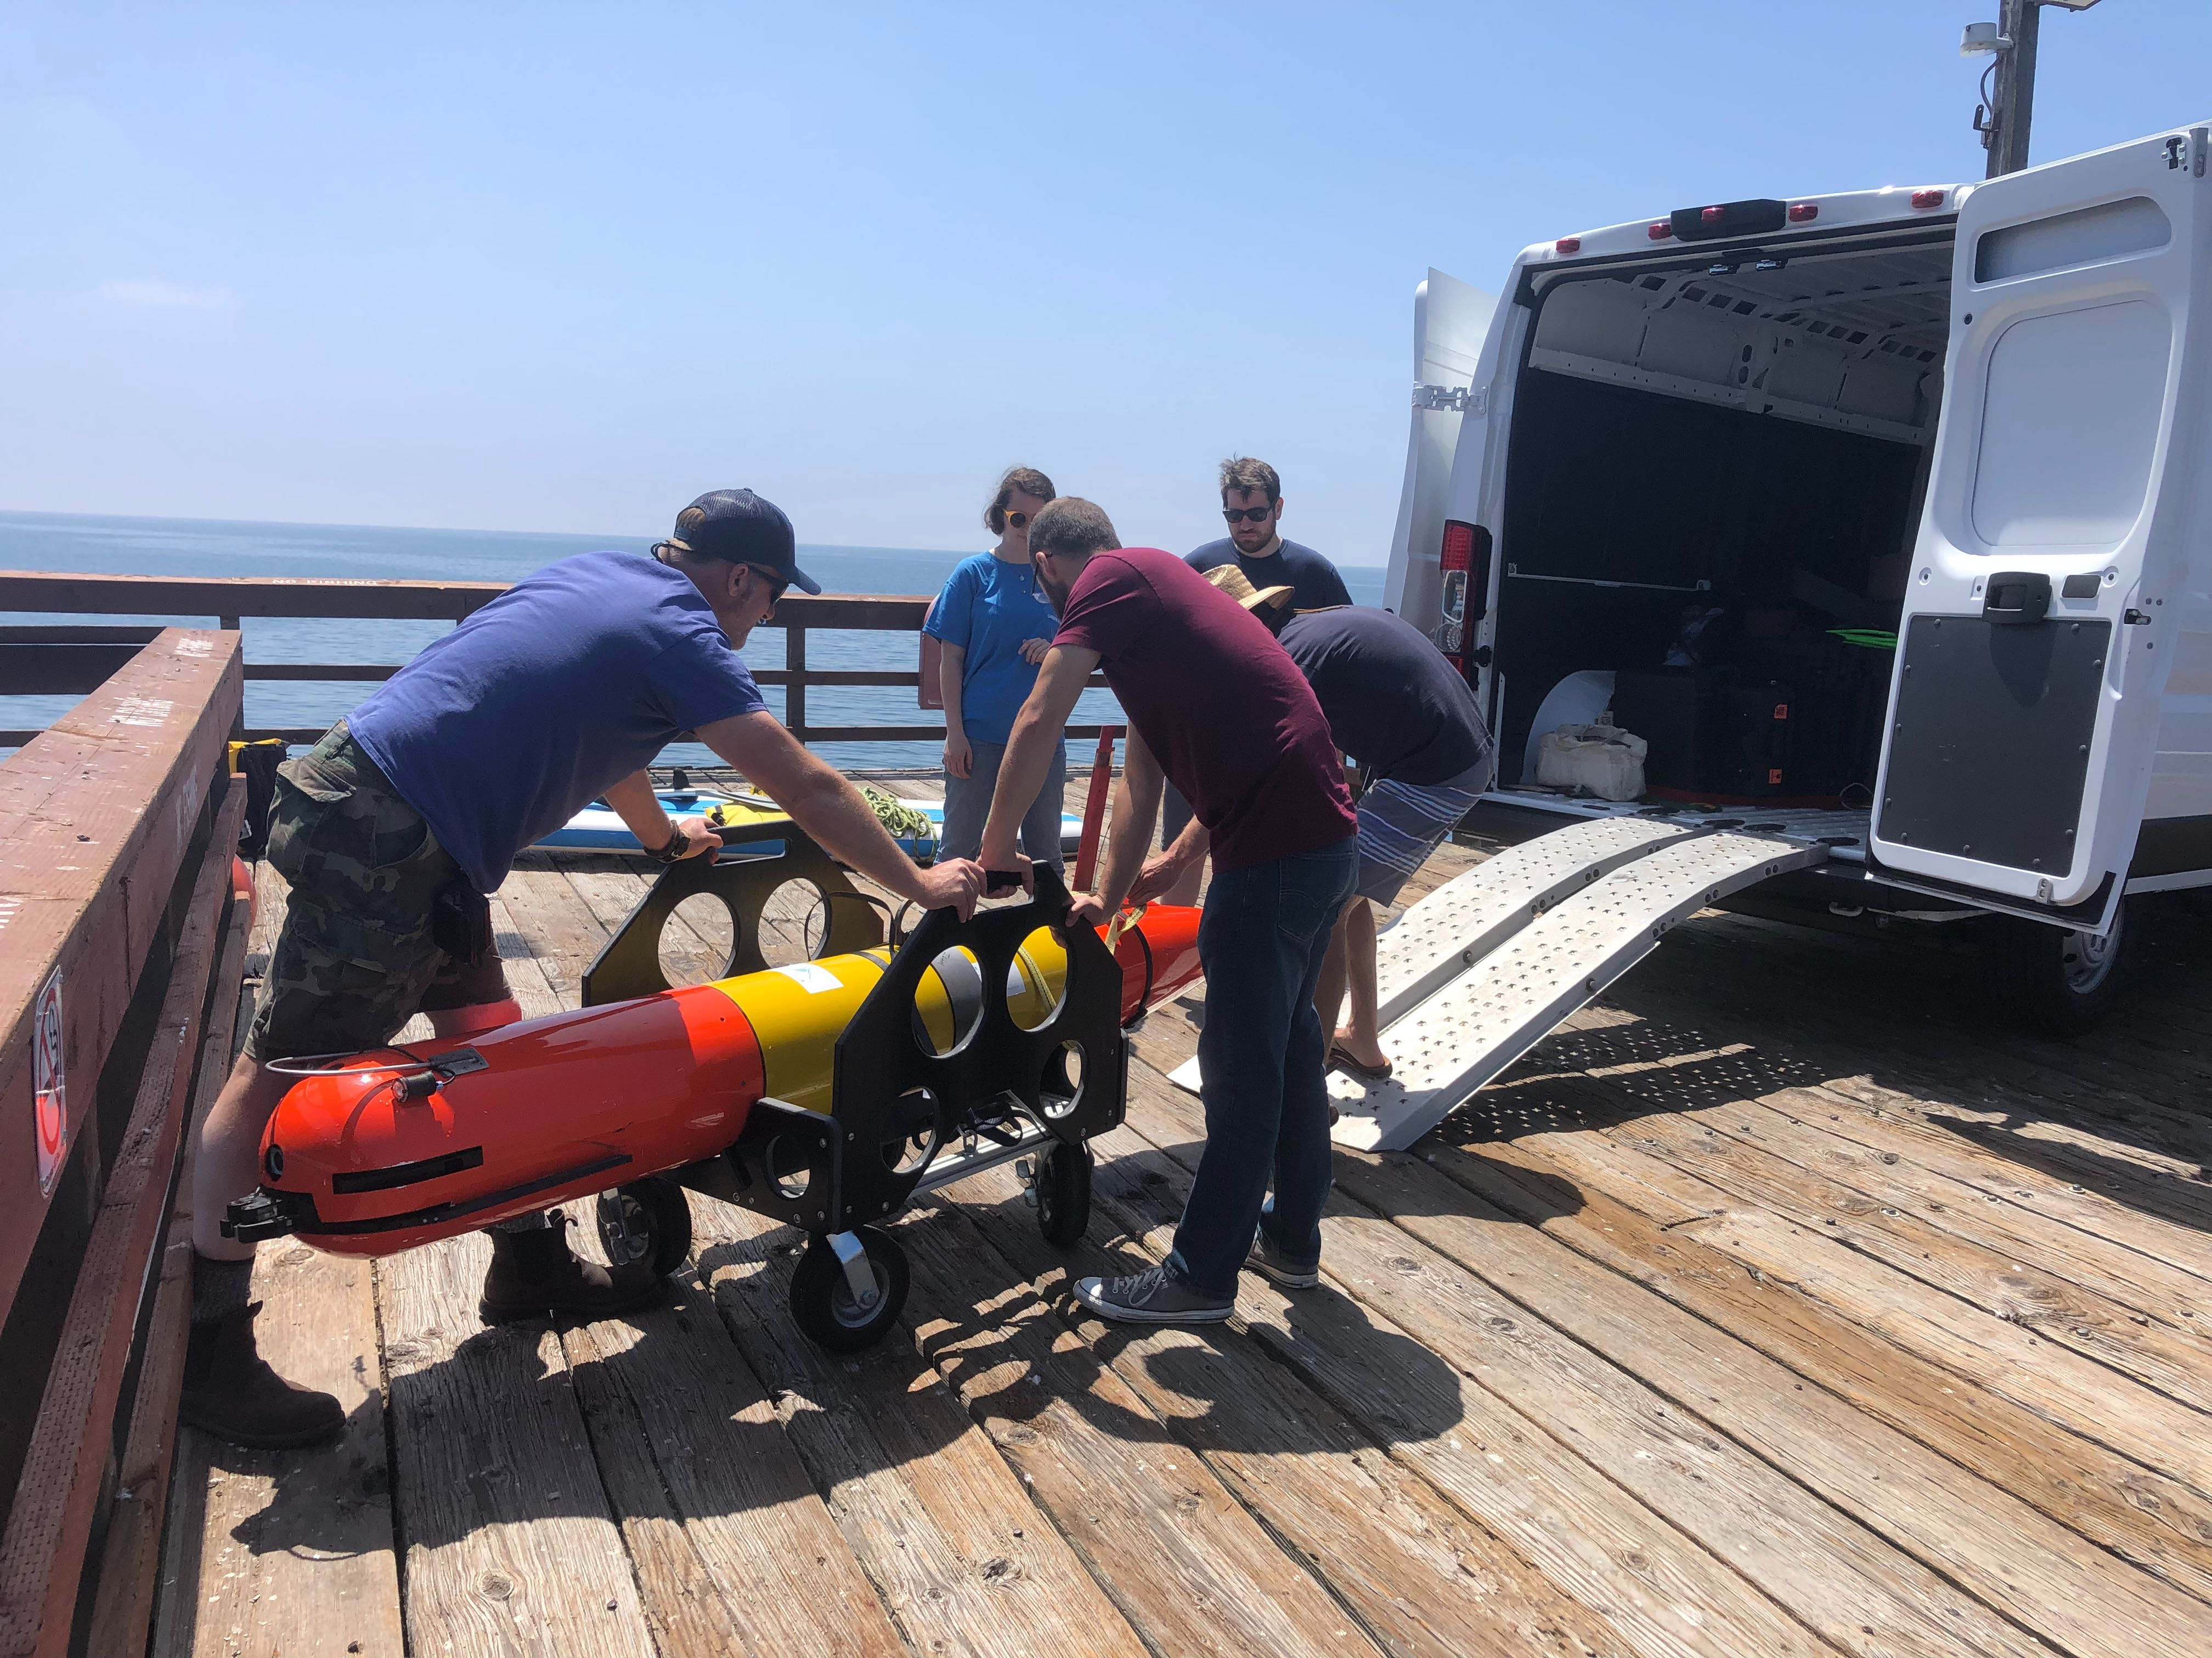
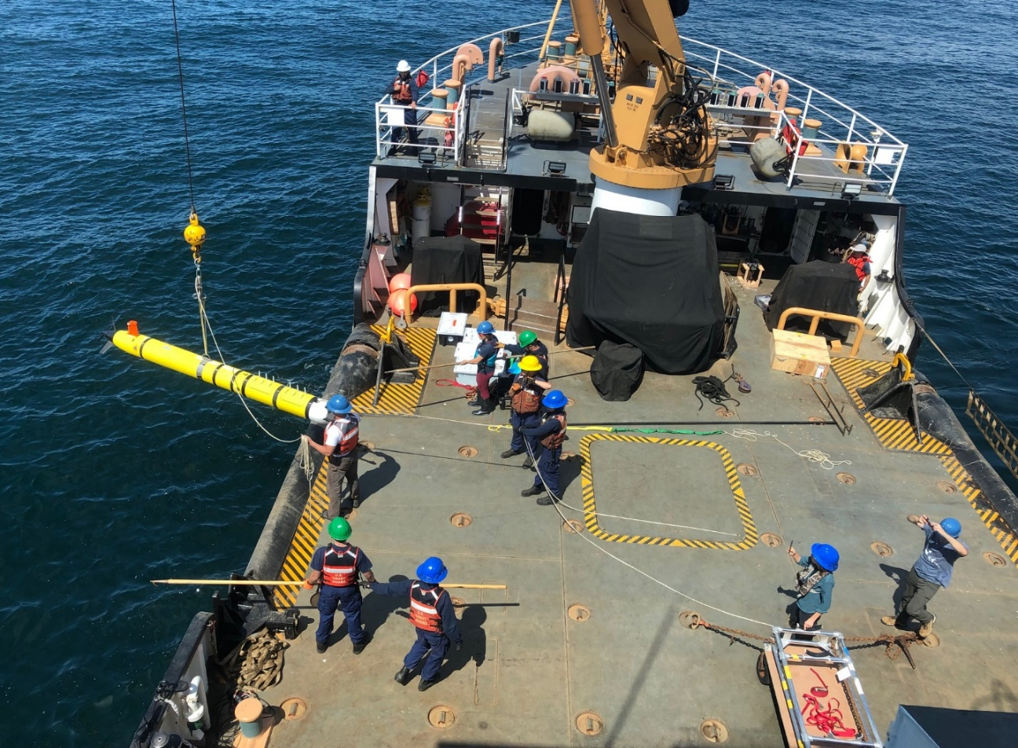
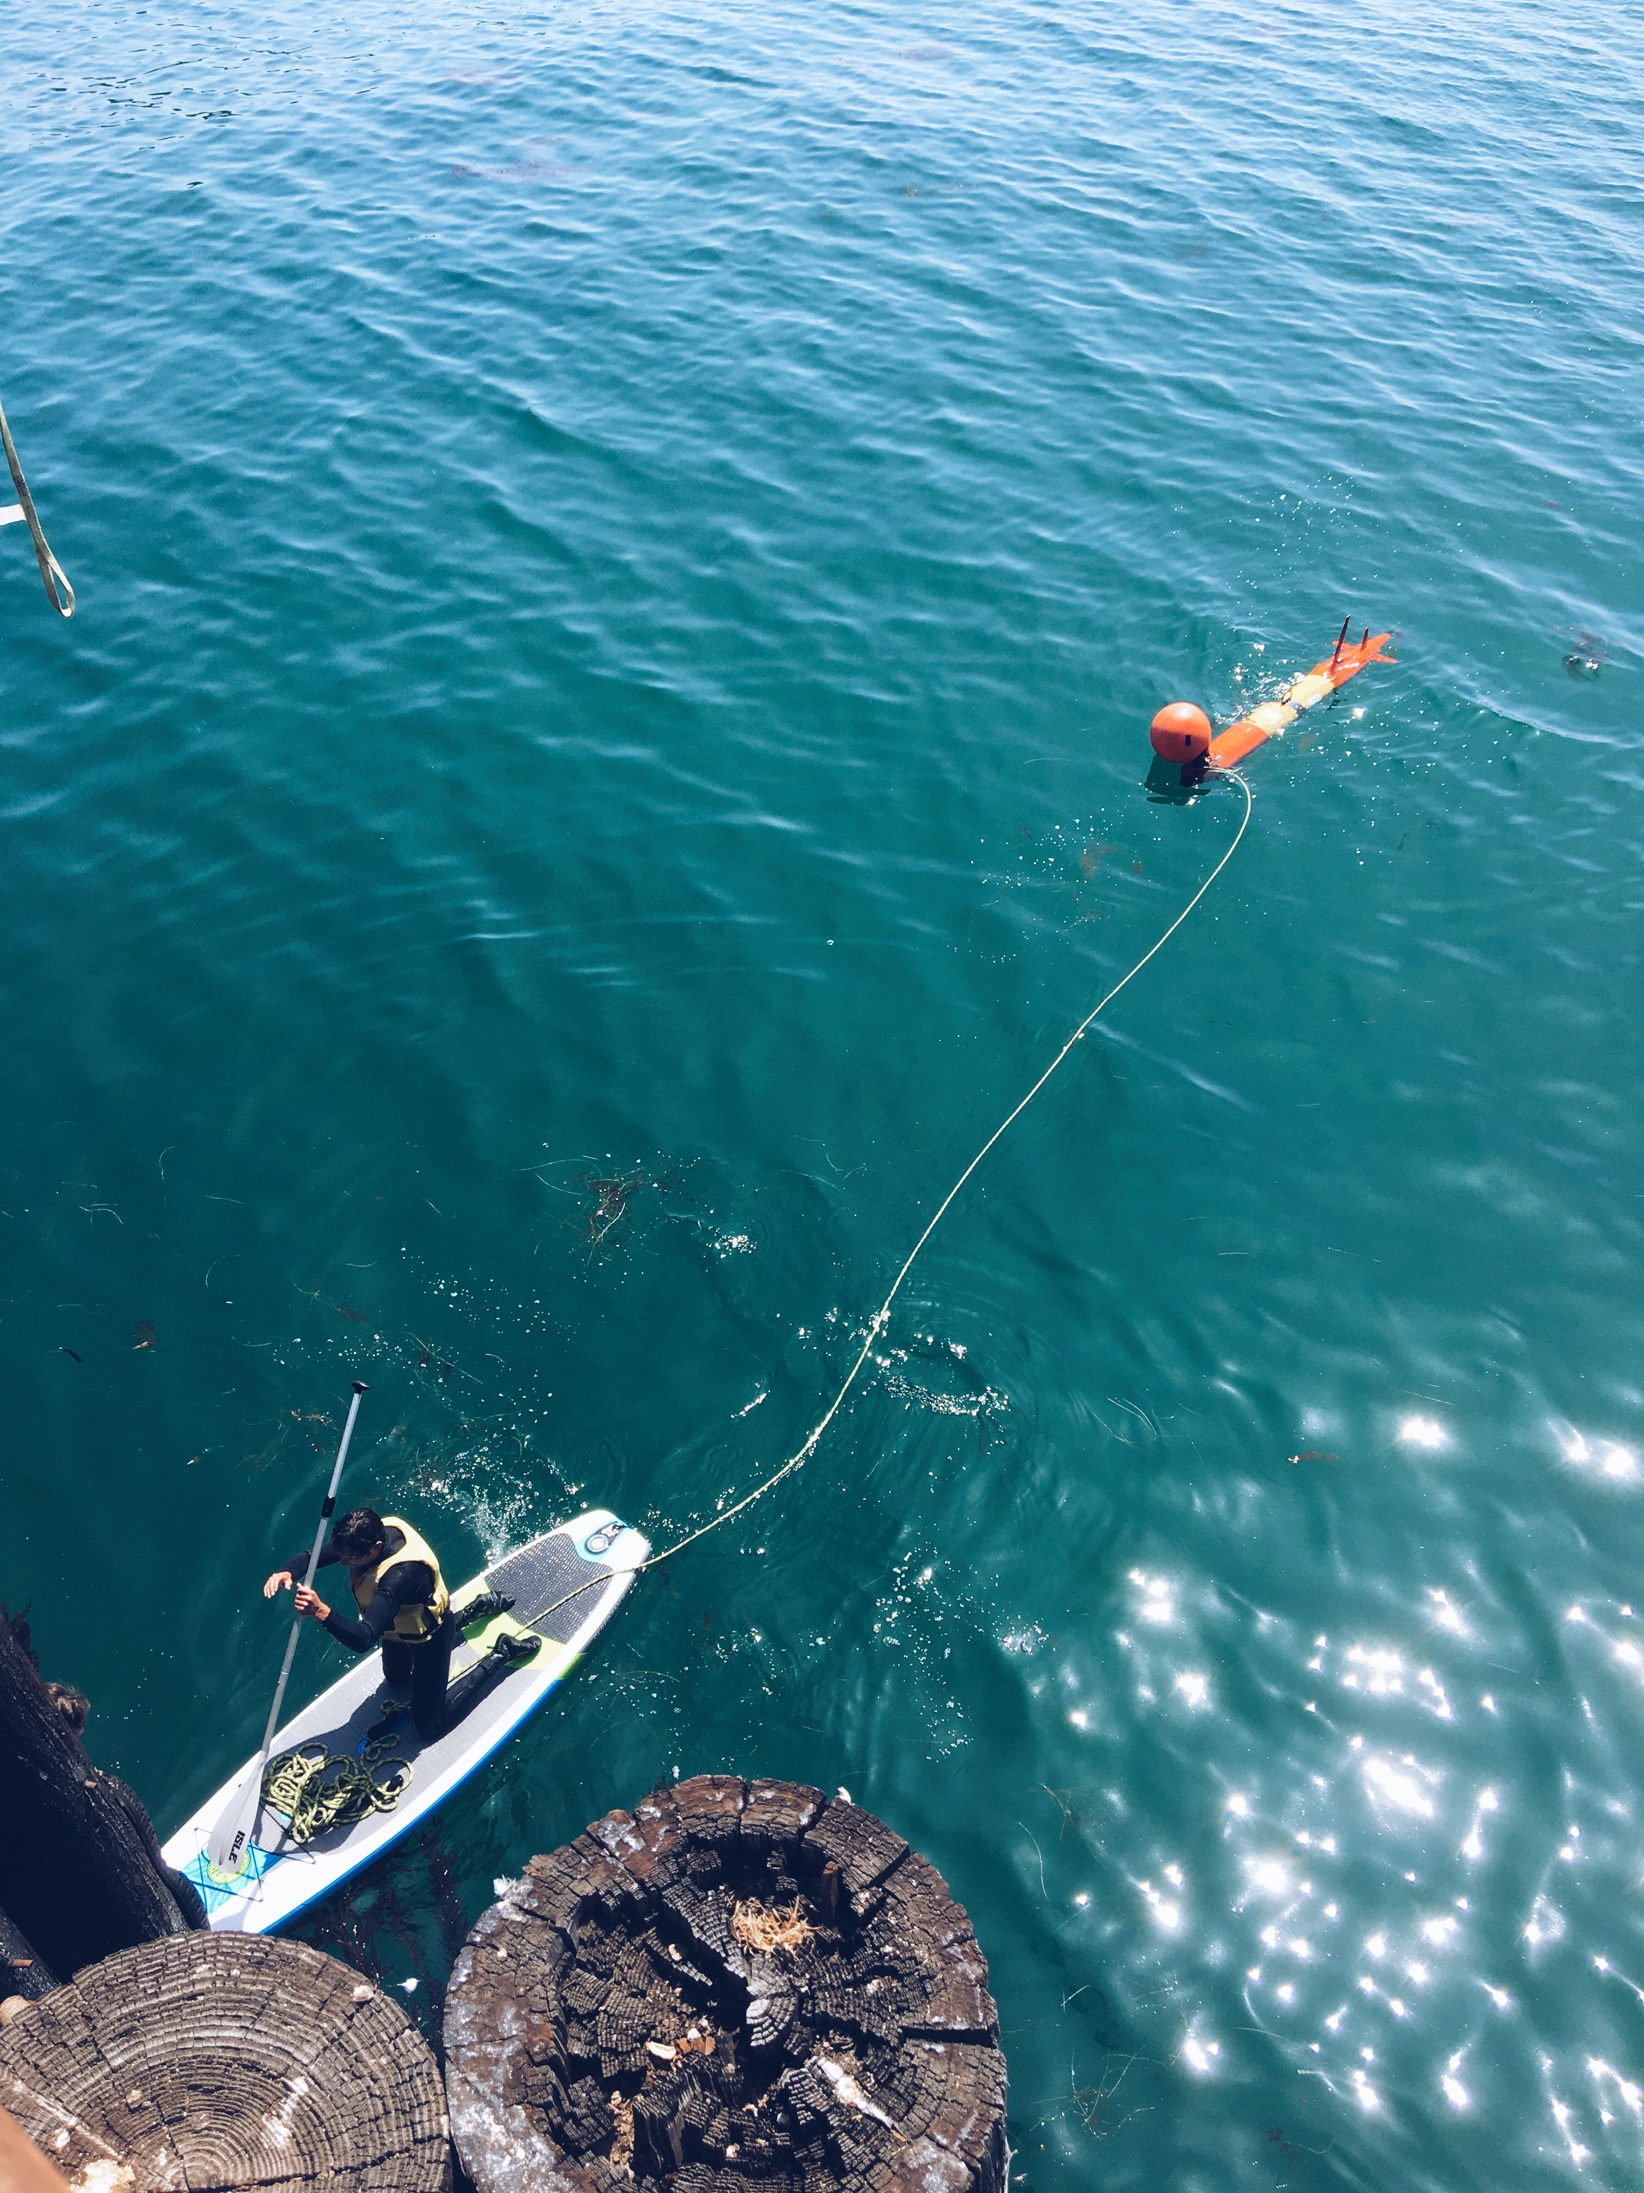
Goletta Pier, LRAUV deployment
USCG Coast Guard Buoy Tender, George Cobb

Slide 31

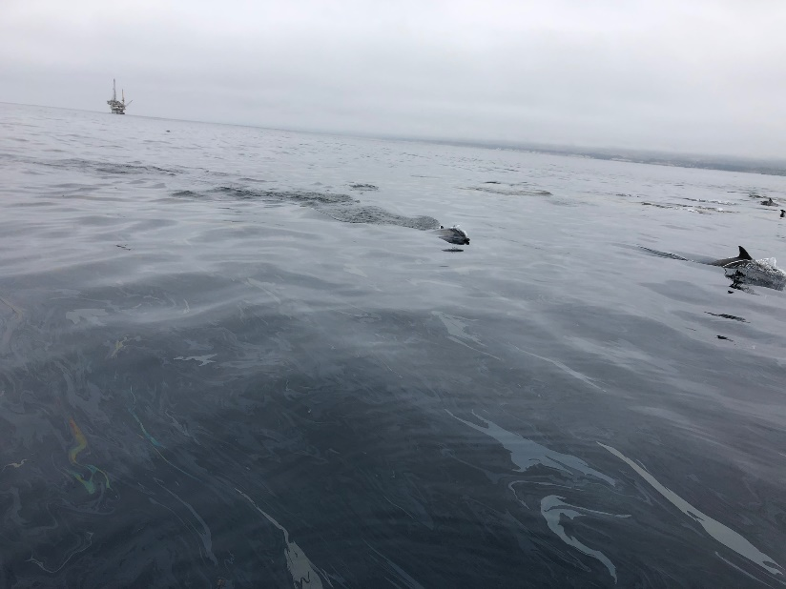
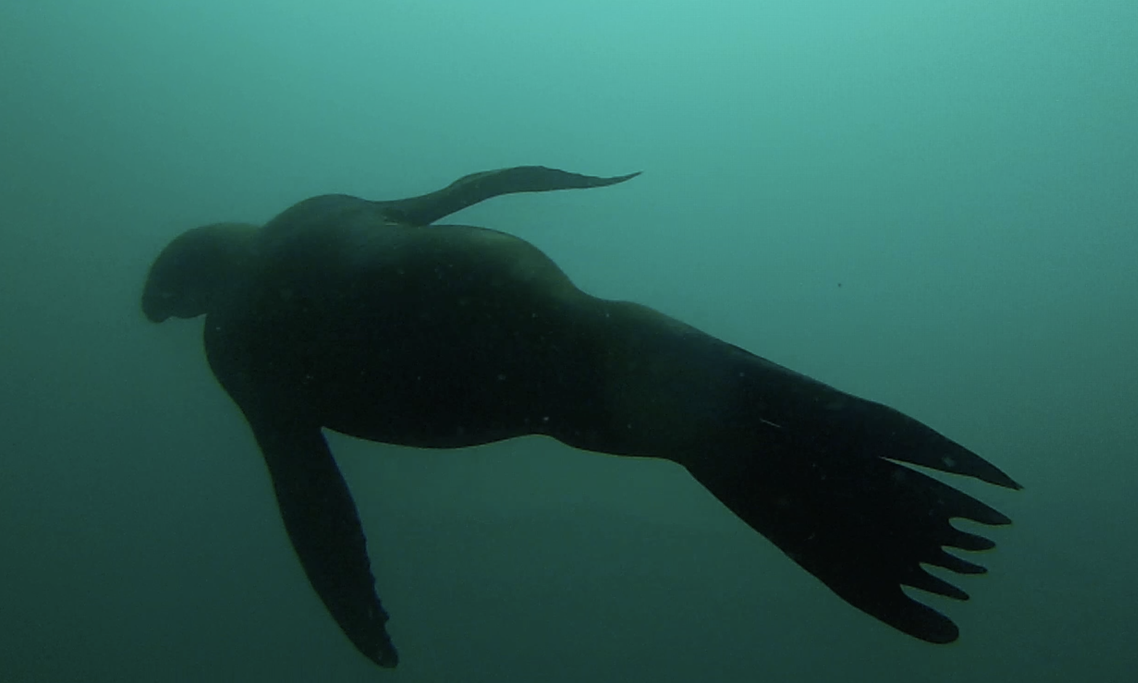
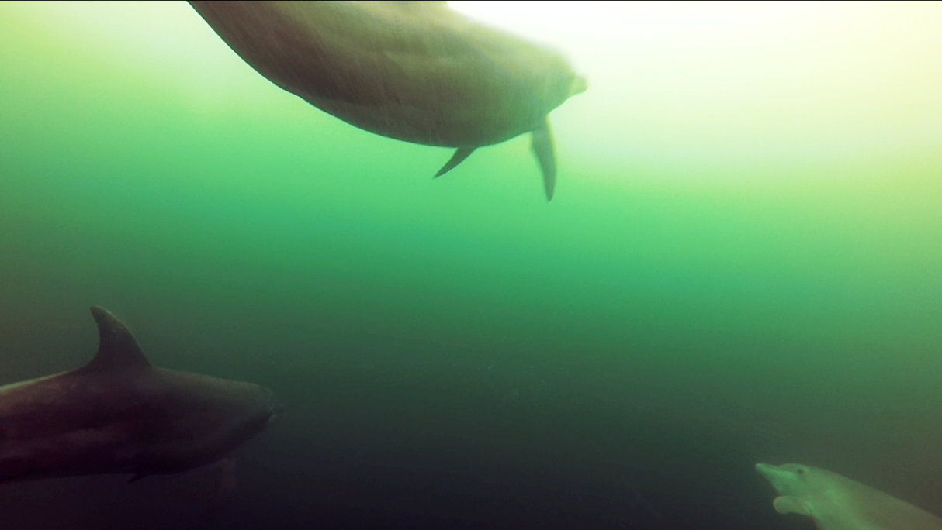
ADAC Program Year 6 Annual Meeting 14 May 2020
Environmental Observations

Slide 32
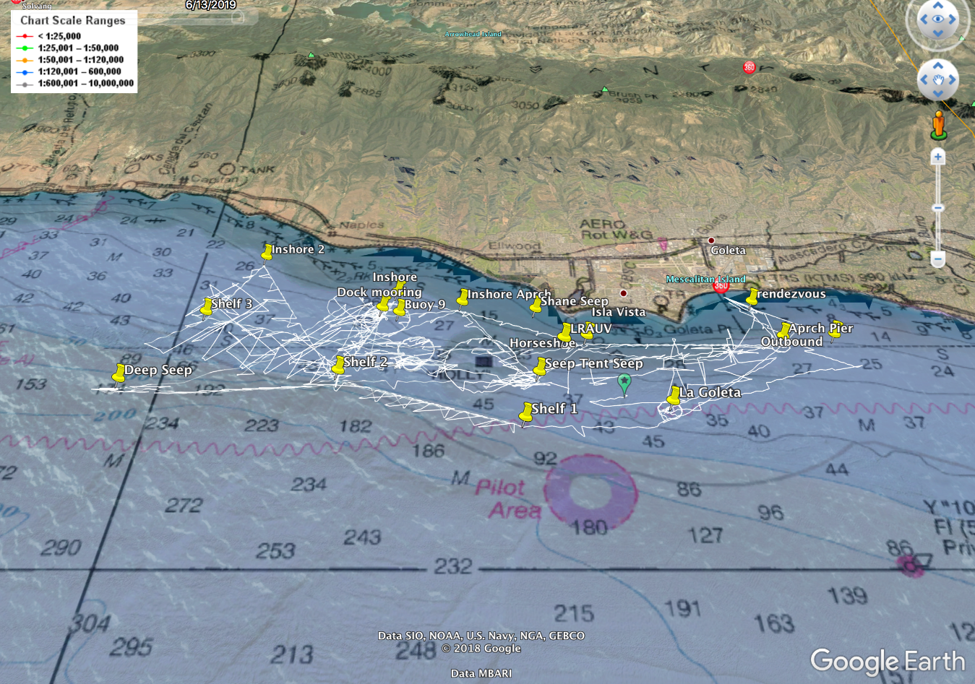
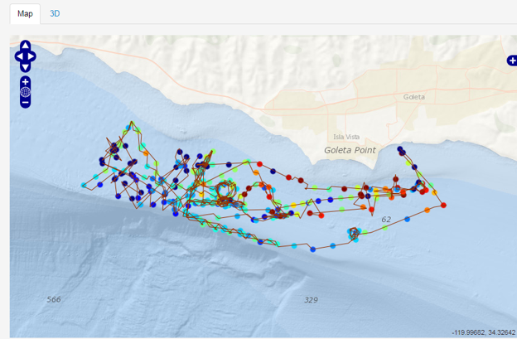

ADAC Program Year 6 Annual Meeting 14 May 2020
Polaris tracks and heat map

Slide 33


ADAC Program Year 6 Annual Meeting 14 May 2020
Surface oil does not correlate with subsurface detections

Slide 34
ADAC Program Year 6 Annual Meeting 14 May 2020
Docking

Slide 35


ADAC Program Year 6 Annual Meeting 14 May 2020
transponder
Latch
Whiskers recessed
Latch

Slide 36

Notes:
/Docking

Slide 37


ADAC Program Year 6 Annual Meeting 14 May 2020
Docking video, state reporting and range plots show successful or unsuccessful docking

Slide 38

ADAC Program Year 6 Annual Meeting 14 May 2020
New Software development:
Line-capture missions
  Docking behavior
  Undocking behavior
Under-ice default Science mission (Sci2)- no more surfacing! Employ ACOMMS
Patch tracking, profile station, waypoint following
Software decision tree for the default under ice mission
Notes:
In the original software developed by MBARI, when the vehicle completes a mission or when it experiences a critical failure, it reverts to a “default mission” in which the vehicle returns to the surface. This allows for cellular or iridium communication to diagnose the problem, or simply command another mission. Naturally, in order to operate under the ice, where surfacing the vehicle is not an option, a new “default mission” needed to be put in place. In the under-ice default mission, the vehicle returns to the dock instead, so the vehicle will be in range for strong ACOMMS, and latched in a known location.

Slide 39
ADAC Program Year 6 Annual Meeting 14 May 2020
Under-ice Tests: Bog Lake, Northfield Maine
February 8-12, 2020
Ice was hard to find in 2019/2020 on East Coast
Lake Winnipesauke, NH
Lake Superior, Great Lakes, Michigan
Bog Lake, Northfield Maine

Slide 40



ADAC Program Year 6 Annual Meeting 14 May 2020
New England Under-Ice
LRAUV Polaris was run on 3 deployments, two in Buzzard’s Bay and one in Bog Lake, for a total of approximately 105 hours.

Slide 41
Under-ice operations: Bog Lake
Notes:
Bog Lake drone zoom in 2020

Slide 42
ADAC Program Year 6 Annual Meeting 14 May 2020
Test Objectives:
Conduct first ever LRAUV under-ice mission
Test new behaviors in a real ice environment to undock, dock, and repeat
Test remote command control from an ice-hole via the Arctic buoy gateway
Send new commands via Gateway/ACCOMS
Find hole objective, if lost, circle
Robust test of all new software behaviors including,
  voltage limits of docking mechanism and cold weather impacts,
  changing undocking behaviors so vehicle would not get hung up on mooring
  Detecting cable present/not present for docking objective
Test recovery and backup capabilities
Test USBL Nav resets
Still need to test:
Multiple buoy nav and dock, leap-frog
LBL
Long range mission
Leave baseline and return
Need to refine undocking to include reverse propulsion
CUSBL

Slide 43




ADAC Program Year 6 Annual Meeting 14 May 2020

Slide 44


ADAC Program Year 6 Annual Meeting 14 May 2020
LRAUV has its own hot spot allowing operators to direct connect for mission checkouts and programming

Slide 45




ADAC Program Year 6 Annual Meeting 14 May 2020

Slide 46
Notes:
Bog Lake Scrapping under-ice, need to re-design antenna

Slide 47

ADAC Program Year 6 Annual Meeting 14 May 2020
Emergency Location of a Lost Vehicle
What’s in the nose:
Emergency Strobe
Backup acoustic transponder
Ranging and acoustic data packet (position/depth info)
Avalanche beacon
RF radio
Argos
Backup strobe
Drop weight

Slide 48
Notes:
Under-ice recovery of Polaris at Bog Lake 2020

Slide 49
ADAC Program Year 6 Annual Meeting 14 May 2020
Current Testing

Slide 50
ADAC Program Year 6 Annual Meeting 14 May 2020
Technology Review: Evaluate & Improve
Testing Forward looking DUSBL vs Circular or 360 DUSBL
Polaris and one buoy was deployed 5/7 in Buzzard’s Bay, Woods Hole to apply software fixes from lesson’s learned in Bog Lake
  Run constant depth mission after a balance and trim and compass calibration to evaluate vehicle stability and nav accuracy prior to docking tries
  Evaluate current undocking behavior (not well suited for shallow water)
Evaluating antenna design and improve robustness, performance. Make spares
Evaluating INS for low power, performance and ease of integration
Making the endcap wiring more modular for swapping out sensor payloads (like sonar and cameras)

Slide 51

SharkCam

Slide 52



ADAC Program Year 6 Annual Meeting 14 May 2020
Multibeam
Two choices under consideration:
Norbit WBMS (60W 10-28VDC, 110-240VAC)
R2Sonic 2020 Wideband multibeam echosounder system (20W avg 90-260VAC; 45-65Hz
We want our sonar to be:
Low power
Easy to digest data and evaluate
Be compact
Low cost
Be easy to flip up or down for bottom mapping or ice keel mapping
Notes:
Norbit 400kHz (Frequency Agility 200-700kHz) WBMS Bathymetric System
integrated with Real-time Sonar Head Sound Velocity Sensor. Includes
Snippets, Sidescan, Backscatter and Water Column Output. Includes Sonar
Interface Unit (SIU-I)
R2Sonic AUV-Sonic 2020 (4000 m rated) Wideband Multi Beam Echo-Sounder System incl:
• 1x Wideband Receiver/Projector, 200-450 kHz,
o 1.8° Beamwidth @ 450 kHz
o 4000 m Depth Rating Switchable Forward-Looking Sonar Imagery Output $ 8,900
1x MultiSpectral Snippets & TruePix™ Backscatter Output $ 6,675
1x Ultra High Resolution 700 kHz $ 6,675
1° x 1° Beamwidth over 70° swath
1x Raw Water Column Data Output

Slide 53
ADAC Program Year 6 Annual Meeting
Summary
Planned outcomes of the research:
  A portable Long Range AUV, for under-ice anomaly and oil detection with deployable arctic buoys for aided navigation, remote communication and docking; around-the-clock expertise available and training with a TRL 7/8 system ready for low-rate manufacturing and payload capability expansion.
Additional research identification:
  Service for hire
  Interest in commercialization
  Interest in scientific community to use and develop tech (BSEE, EPA, NOAA, etc.)

Slide 54
LRAUV Ready for questions
ADAC Program Year 6 Annual Meeting 14 May 2020
What needs improvement or is missing?
  Sensing of oil against the ice and seafloor
  More sensor payloads-Echosounders, Cameras, Water sampling, energy harvesting
  Lower vehicle costs, Design review?
  More operational time for shake-down and training
  Software development (behaviors) and backseat autonomy
Who should we connect with to improve odds of success?
  Engage with USCG operators early
  Broaden R&D support
  Need to coordinate field operations with first responders and fill technology gaps that are identified.
  Continue to connect with alternative funding sources like ONR, NOAA and BSEE to help fund operations and sensor development (methane, what else?)
  Need more vehicles?
Input on future from you: Do we need 2, 5, 10 vehicles?
Notes:
Thank you for the gift of your time and attention.

Slide 55

ADAC Program Year 6 Annual Meeting 14 May 2020

Slide 56
ADAC Program Year 6 Annual Meeting 14 May 2020
Extra Slides

Slide 57

Project LRAUV: Transition Plans
ADAC Program Year 6 Annual Meeting 14 May 2020
Pathway to Transition:
Create an operational system that the USCG can use for characterizing spills in ice-covered ocean environments. Transition advantages of the LRAUV platform:
  Contains commercially available sensors
  Can be replicated for the USCG
  Has a proven vehicle design and proven reliability
  Sensor commonality

Slide 58
Project LRAUV: Transition Plans
ADAC Program Year 6 Annual Meeting 14 May 2020
Transition Plan includes the following:
  Facilities: WHOI operates facilities for fabrication, testing, logistics (on-ice support) and platforms such as ALVIN
  Service for-Hire: Operators and AUV’s such as the REMUS are available for hire and also have been transitioned into both the Navy and commercial sectors
  Hardware Builds: WHOI has a history of replicating systems and training end users
  Commercialization: Demand for WHOI built systems may occur through spin-off companies or through licensing the technology to a commercial entity. (example: Hydroid Kongsberg with REMUS and Bluefin from MIT, Bellingham)

Slide 59


Project LRAUV: Transition Plans
ADAC Program Year 6 Annual Meeting 14 May 2020
Two-Stage Transition Plan:
  Build one or more systems to support USCG complete with successful open-water and under-ice demonstrations. WHOI trains USCG operators with support funding. WHOI can support USCG on site or remotely via iridium vehicle communications as needed. 24 hr support possible.
  Commercialize resulting platform: Based on lessons learned from (1), prepare the system for commercialization by accessing WHOI CMR fabrication resources. LRAUV was not designed for efficiency of manufacturing and rapid prototyping, therefore revisiting AUV design is a top priority.

Slide 60

Polaris

Slide 61
Project LRAUV: Low Cost Vehicle
ADAC Program Year 6 Annual Meeting 14 May 2020
    Projected- Perform low cost vehicle study at DunkWorks
    Reduced Cost Vehicle Fabrication: Using WHOI's maker space known as Dunk Works, the WHOI LRAUV team along with designated student interns accomplished the following in order to reduce vehicle costs:
    Evaluate LRAUV BOMs and identify machined parts that can be 3D printed with less people labor and less expensive materials.
    Produce drawings and prototypes of vehicle components, such as chassis, end comes, end caps, vehicle shells, etc.
    Evaluate third party licensing of the LRAUV with MBARI approval.

Slide 62

Project LRAUV: Metrics
ADAC Program Year 6 Annual Meeting 14 May 2020
  Original YR1 metrics:
    Performance-specific measures:
      Detection level of oil: measured in terms of minimum sensitivity Target: < 80 ppb.
      *Range and endurance: Target: 300 km on secondary (chargeable) batteries, >twice that on primary (disposable).
      Adaptive sampling performance- mapping of spill extent: Target: Area coverage 1000 km2 per vehicle deployment (lane spacing TBD, e.g. 30 km x 30 km, 1 km grid).
    Operator ease of use:
      Logistical footprint: number of operators required on site, number of kilograms to be transported. Target: 2-3 and < 600kg.
      Ease of mission configuration: time to specify grid survey: Target: < 1 hr.
      Ease of remote interaction: training time required for operators: Training: < 1 week.

Slide 63



ADAC Program Year 6 Annual Meeting 14 May 2020
As a long-range AUV, LRAUV was able to swim for a week informing other assets where oil was and was not on any given day
This allowed for large ships with multiple sampling devices to focus on ‘hot spots’

Slide 64


ADAC Program Year 6 Annual Meeting 14 May 2020
Data: Oil constantly on the move
Modeling and intimate knowledge of AOI is important
Notes:
Keeping assets in the water around the clock is key to understanding impacts and informing response efforts.

