Slide 1
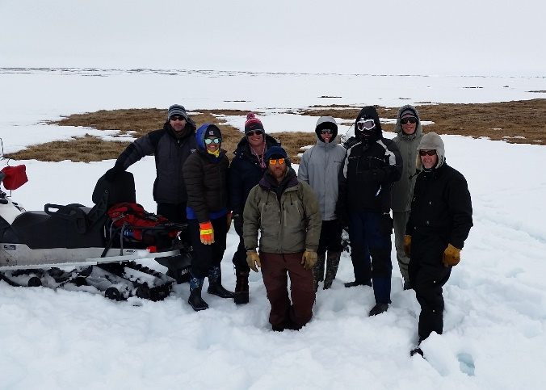
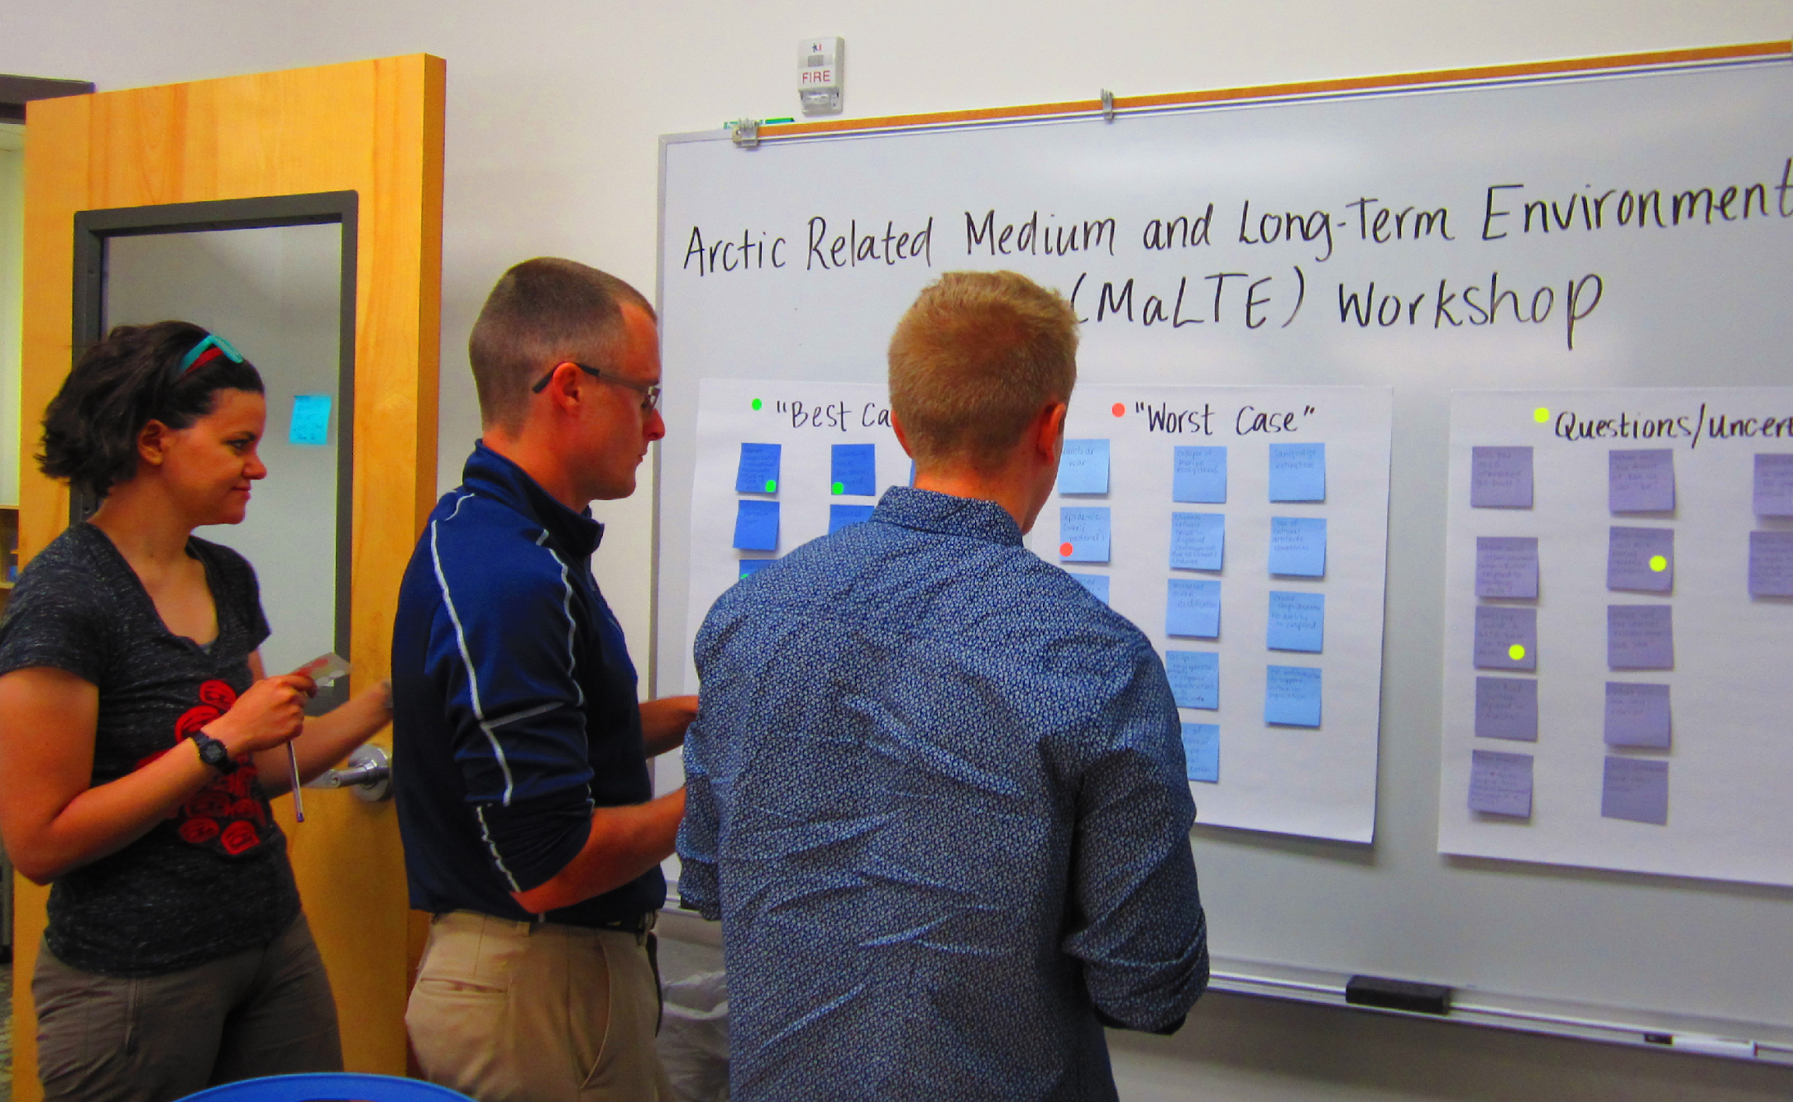
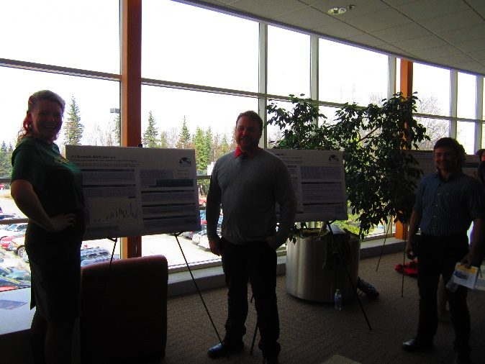
ADAC Year 5 Annual Meeting
ADAC Project Briefing
ADAC’s Integrated Education Programs
Ellee Matthews, ADAC Education & Administrative Manager

Slide 2
Integrated Education Overview
ADAC Program Year 5 Annual Meeting 11-12 April 2019
Education outreach and workforce development is a core mission for ADAC. The intent of ADAC’s education program is to contribute to the next generation of Science, Technology, Engineering, and Mathematics (STEM) professionals for the Homeland Security Enterprise (HSE). ADAC’s geographic focus on the Arctic is unique in the DHS S&T OUP portfolio. The Arctic focused research led by ADAC offers ADAC fellows a variety of unique research and development opportunities to engage with research aimed specifically to respond to the challenges faced by the USCG and other DHS maritime missions operating in the High North.

Slide 3
ADAC Fellows Program: Eligibility, Commitment, & Support
ADAC Program Year 5 Annual Meeting 11-12 April 2019
ADAC Fellows program is open to undergraduate, graduate and advanced graduate students. The following apply to all fellows:
Eligibility requirements:
◦ U.S. citizenship
◦ Must major in a STEM discipline
◦ Need to be able to pass a background check
◦ Achieve & maintain a cumulative GPA of 3.30 or higher while in the program
Commitment:
◦ Complete two 10-week summer internships while in the program
◦ Actively seek and obtain employment in the Homeland Security Enterprise for at least one year after graduation.
Note: Employment can be at the state, federal or local level. Undergraduate Fellows can also defer employment to attend graduate school.
Support:
◦ Monthly stipend and tuition support (fall & spring semesters only) at defined levels for undergraduate & graduate students
◦ Assistance in securing a 10-week internship for two summers.
◦ Mentoring and professional development through ADAC network.

Slide 4
ADAC Fellowship Program: Structure
ADAC Program Year 5 Annual Meeting 11-12 April 2019
The ADAC Fellowship program is comprised of three major components:
Career Development Grant (CDG)
Workforce Development (WFD)
ADAC Fellowship Program
Integrated Minority Serving Institute (MSI)/Arctic Summer Internship Program (ASIP) 2019

Slide 5
Career Development Grant (CDG)
ADAC Program Year 5 Annual Meeting 11-12 April 2019
ADAC’s CDG Fellows are funded via a DHS S&T OUP Supplemental Award provided in February 2016 as the initial element of the overall ADAC Fellowship Program
  The DHS S&T OUP CDG Supplemental Award will be exhausted at the end of ADAC’s Program Year 5
Project Objectives:
Attract the highest caliber undergraduate and graduate students to our science and engineering programs at UAA.
Nurture and train these students for careers in DHS — related applied fields of science and technology.
Provide students with opportunities for direct involvement in DHS operations and embedded research among our DHS collaborators and stakeholders.
Provide education and mentorship to students that leads to timely completion of degrees and fulfilling careers in DHS Enterprise.
Potential Impact:
Contribute to the growth of highly skilled workforce for Homeland Security agencies
Contribute to the capability of USCG Operator and in support of USCG missions in the Arctic.
Workforce Development
Career Development Grant (CDG)
MSI/ASIP 2019
ADAC Fellowship Program

Slide 6
Workforce Development (WFD)
ADAC Program Year 5 Annual Meeting 11-12 April 2019
ADAC’s WFD Fellows are funded via a DHS S&T OUP Cooperative Grant
  Since the DHS CDG Supplemental Award will be exhausted at the end of Program Year 5, all additional new student fellows are awarded grant funding through the WFD program.
Project Objectives:
Attract the highest caliber undergraduate and graduate students to our science and engineering programs at UAA.
Nurture and train these students for careers in DHS — related applied fields of science and technology.
Provide students with opportunities for direct involvement in DHS operations and embedded research among our DHS collaborators and stakeholders.
Provide education and mentorship to students that leads to timely completion of degrees and fulfilling careers in DHS Enterprise.
Potential Impact:
Contribute to the growth of highly skilled workforce for Homeland Security agencies
Contribute to the capability of USCG Operator and in support of USCG missions in the Arctic.
Workforce Development (WFD)
Career Development Grant (CDG)
MSI/ASIP 2019
ADAC Fellowship Program

Slide 7
Integrated Minority Serving Institute (MSI)/Arctic Summer Internship Project (ASIP)
ADAC Program Year 5 Annual Meeting 11-12 April 2019
Project Description:
In Program Year 5, ADAC will recruit summer interns from under-represented classifications with designated Minority Serving Institutions (MSI) and Significant Minority Enrollment (SME) institutions.
The Minority Summer Internship will integrate these interns along with additional participating ADAC Fellows for a 2019 Arctic Summer Internship Program (ASIP).
ASIP is a comprehensive internship conducted at the University of Alaska (UAA), which will provide students with the opportunity to visit multiple U.S. Federal Agencies with offices in Anchorage, participate in ADAC research, and take part in Arctic field work conducted in Utqiagvik, Alaska
Objective/Purpose:
To provide an Arctic focused summer internship program oriented for MSI’s, under-represented classifications, and other ADAC Fellows as part of the student workforce development and preparation for entry into the Homeland Security Enterprise
Workforce Development (WFD)
Career Development Grant (CDG)
MSI/ASIP 2019
ADAC Fellowship Program

Slide 8
Current Status: ADAC’s CDG & WFD Programs

Slide 9
Current ADAC Fellows – Program Year 5
(July 1, 2018 - June 30, 2019)
ADAC Program Year 5 Annual Meeting 11-12 April 2019
Arctic Domain Awareness Center - Program Year 5
 | University of Alaska Anchorage, AK (UAA) | University of Alaska Fairbanks, AK (UAF) | University of Texas at El Paso, TX (UTEP)* | University of New Hampshire (UNH) | Tiffin University, OH | U.S. Naval Academy (USNA)
Undergraduate | 9 | 0 | 2 | 2 | 1 | 1 *Currently Inactive
Graduate | 3 | 1*Currently Inactive | 0 | 0 | 0 | 0
Total | 9 | 1 | 2 | 2 | 1 | 1
Total Overall Active Fellows: | 18
* An accredited MSI institution

Slide 10
Breakdown of Active CDG & WFD Fellows
Program Year 5
ADAC Program Year 5 Annual Meeting 11-12 April 2019
Arctic Domain Awareness Center – Active CDG & WFD Fellows
 | Career Development Grant (CDG) | Work Force Development (WFD)
Undergraduate | 4 | 9
Graduate | 0 | 3
Total | 4 | 12
Total Overall Active Fellows: | 16
* An accredited MSI institution

Slide 11
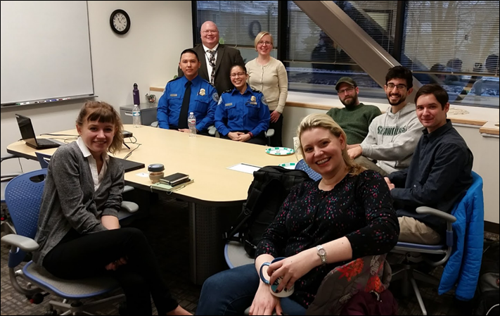
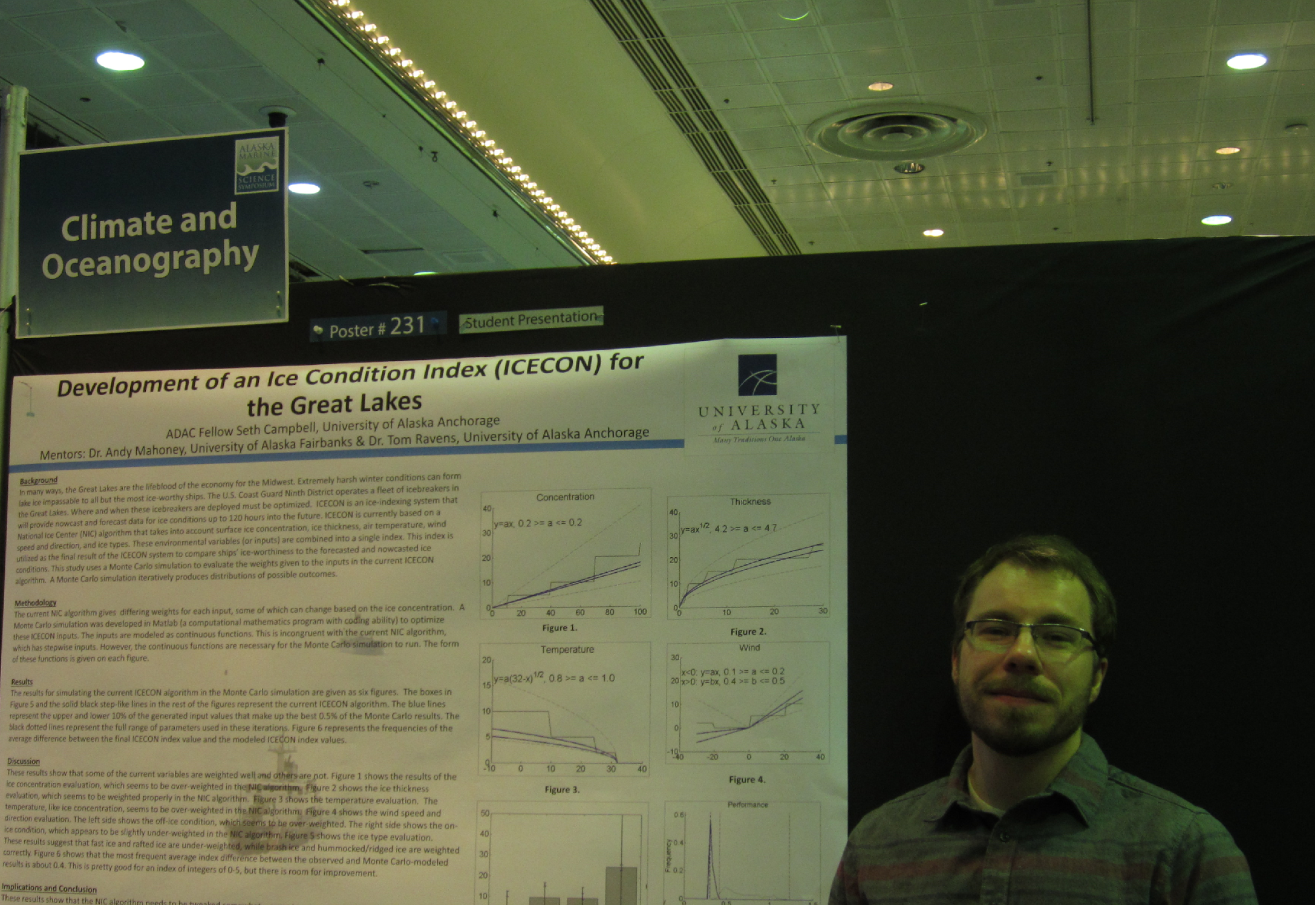
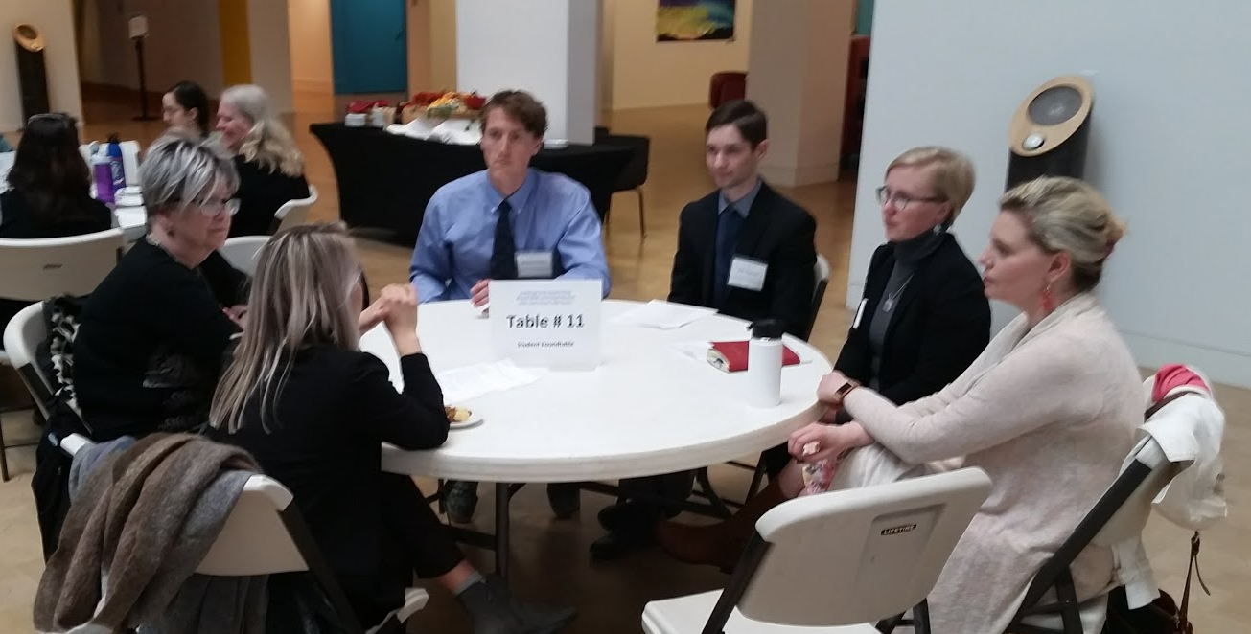
Progress: Outreach, Exchange, & Activities
ADAC Program Year 5 Annual Meeting 11-12 April 2019
  Past Events:
August 2018 - Arctic Maritime Symposium, Anchorage Alaska’
January 2019 - Arctic Senior Leaders Summit, Fort McNair, Washington D.C.
Planned Future Events:
April 2019 – ADAC Annual Meeting, Washington D.C.
May 2019 – Anchorage Arctic Research Day, Anchorage, Alaska
May 2019 – Arctic Incidence of National Significance: “Stressing the System…Managing a Complex Arctic Crisis”
June 2019 – Arctic Summer Internship Program (ASIP), Anchorage and Utqiagvik, Alaska
June 2019 – Medium and Long-Term Environment (MaLTE) Workshop: “Arctic Futures...Opportunities for Better Arctic Security via a ‘Blue Economy’ connection?”; Utqiagvik, Alaska

Slide 12
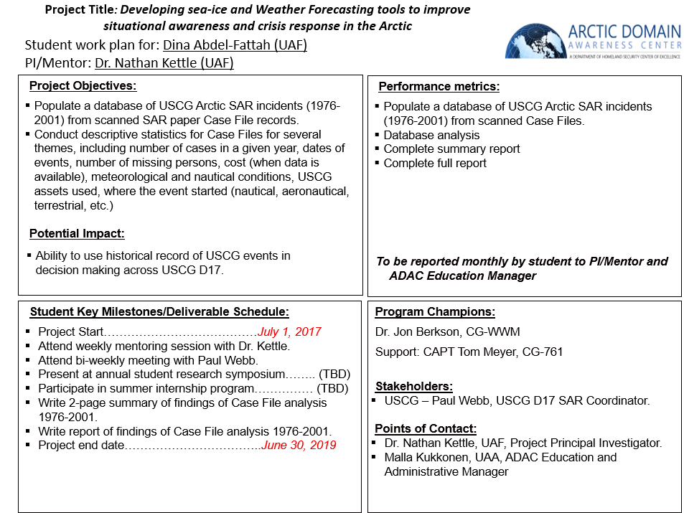
ADAC Project Engagement– Work Plans
ADAC Program Year 5 Annual Meeting 11-12 April 2019
Each Fellow has an individually developed work plan for their engagement in an ADAC project, Center-led activities, or both.
Developed in collaboration with Project PI/Lead, ADAC Fellow, ADAC Executive Director, and ADAC Education & Administrative Manager.
Revisited after each semester.
Student Project Work Plan Example

Slide 13
Current Student Research Engagement in ADAC Supported Projects
ADAC Program Year 5 Annual Meeting 11-12 April 2019
Project Name | Fellow(s) on Project | University
Arctic Vessel Monitoring/Geofencing: | UG Fellow - Max Zaki | UAA
Arctic Oil Spill Modeling | GRD Fellow - Tristan Goers | UAA
Arctic Oil Spill Modeling Strategies | UG Fellows - Jessica Manning & Megan Verfaillie | UNH
Arctic Mussels | UG Fellows - Stacey Hanson & Cameron Carlson | UAA
ICECON for the Great Lakes | UG Fellows - Kelsey Frazier & Jack McCaslin | UAA
Alaska-Norway Project | UG Fellow - Cameron Carlson GRD Fellow - Kelly Ireland | UAA
Remote Deployed Sensors Project | UG Fellow - Hector Dominguez | UTEP
Topo-Bathy Data Sets Project | UG Fellow - Daniel Cruz | UTEP
ADAC Center Activity – Arctic IoNS Literature Review | UG Fellow - Richard McElmery GRD Fellows - Sarah Gering & Kelly Ireland | UAA
ADAC Center Activity – Arctic Shipping Paper | UG Fellow - Max Zaki GRD Fellow - Sarah Gering | UAA
ADAC Center Support Activities – ASIP, IoNS, and MaLTE Planning | UG Fellows - Richard McElmery & Stacey Hanson | UAA
Notes:
Update this with new students working on Geofencing and ICECON with Dr. Butler

Slide 14
Summer 2019: Ten-Week Internships
ADAC Program Year 5 Annual Meeting 11-12 April 2019
Currently, sixteen of ADAC’s Fellows have secured internships for this summer:
  7 ADAC Fellows – Integrated Minority Internship (MSI)/Arctic Summer Internship Program (ASIP)
  1 ADAC Fellow – Arctic Mussels Project with Dr. Tomco
  1 ADAC Fellow – Engineering internship with British Petroleum (BP) in Anchorage, Alaska
  2 ADAC Fellows– Arctic ICECON Project with Dr. Butler
  2 ADAC Fellows – Arctic Geofencing Project with Dr. Butler
  1 ADAC Fellow – Arctic Maritime Security Center in New Jersey
  1 ADAC Fellow – ADAC Center Activities Internship
  1 ADAC Fellow – Plasma Research Project with Dr. Hicks at UAA
Notes:
Update this with Max’s internship!!

Slide 15
Progress - Graduated ADAC Fellows to Date – Program Year 5
(July 1, 2018- June 30, 2019)
ADAC Program Year 5 Annual Meeting 11-12 April 2019
Graduated Fellows During Program Year 5
 | University of Alaska Anchorage, AK (UAA) | University of Texas at El Paso, TX (UTEP)*
Undergraduate | 0 | 2
Graduate | 3 | 0
Total | 3 | 2
Total Overall Graduated Fellows: | 5
UAA Students
Graduate Fellows
  Jessica Faust – completing teaching commitment (50% complete).
  Leif Hammes - civil engineer, Alaska District U.S. Army Corps of Engineers, JBER.
  Matt Ahlrichs - employed locally, but in applications for National Labs.
UTEP Students
  Roberto Garcia – Enrolled in Electrical & Computer Engineering graduate program at UTEP
  Sebastian Ruiz – Currently working at a technological research lab at UTEP
* An accredited MSI institution

Slide 16
Current Status: ADAC’s Integrated Minority Serving Institute (MSI)/Arctic Summer Internship Program (ASIP)

Slide 17
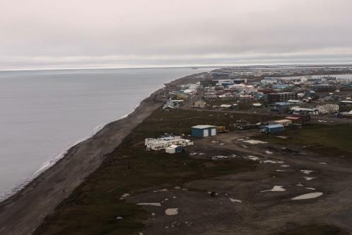
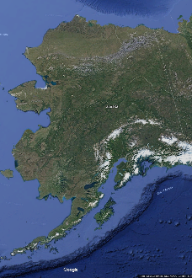
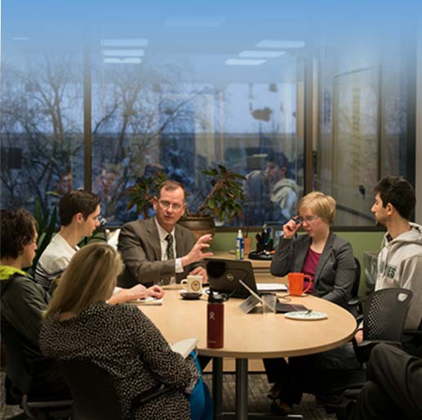
2019 MSI/ASIP Agenda
ADAC Program Year 5 Annual Meeting 11-12 April 2019
Utqiaġvik
Date | Schedule | Location
June 10th – 15th | Orientation and briefing/preparation week. | Anchorage, AK
June 15th – 29th | Field Program & MaLTE Workshop | Utqiagvik, AK
UAA-ADAC

Slide 18
Current Students Confirmed for 2019 MSI/ASIP Program
ADAC Program Year 5 Annual Meeting 11-12 April 2019
Arctic Domain Awareness Center - Program Year 5 Overview of MSI/ASIP Student Interns
 | University of Alaska Anchorage, AK (UAA) | University of Texas at El Paso, TX (UTEP)* | University of New Hampshire (UNH) | U.S. Coast Guard Academy (USCGA) | U.S. Naval Academy (USNA)
Undergraduate | 2 | 2 | 2 | 1 | 2
Graduate | 1 | 0 | 0 | 0 | 0
Total | 3 | 2 | 2 | 1 | 2
Total Overall Active Fellows: | 10
* An accredited MSI institution

Slide 19

In Summary…
In ADAC’s Program Year 5, five Fellows have graduated from the Fellowship program, with two more anticipated to complete the program at the end of this spring 2019 semester.
Career options and interest have been looked at on individual basis, and mentoring by ADAC staff has been tailored to assist graduates to transition to Homeland Security Enterprise related employment.
Notes:
Find the total number of graduates total?? And where they are now??

Slide 20
ADAC Program Year 5 Annual Meeting
“ADAC Fellowship and ASIP Program”
ADAC Fellow, Richard McElmurry, UAA
5 years USAF Russian linguist in AK
USCG, Russian FSB joint operations
6 years US Army Special Forces
Two combat deployments
4 years State Department
ADAC Fellow
University of Alaska Anchorage Environmental Science

Slide 21
ADAC Fellowship and Arctic Summer Internship Programs
ADAC Program Year 5 Annual Meeting 11-12 April 2019
Building the next generation of homeland security experts and operators, through:
  Opportunity
  Education
  Leadership

Slide 22
ADAC Fellowship and Arctic Summer Internship Programs
ADAC Program Year 5 Annual Meeting 11-12 April 2019
Opportunity:
“If you want to know what’s going on in the Arctic, then come here and see.”
Harry K. Brower Jr.
Mayor North Slope Borough

Slide 23
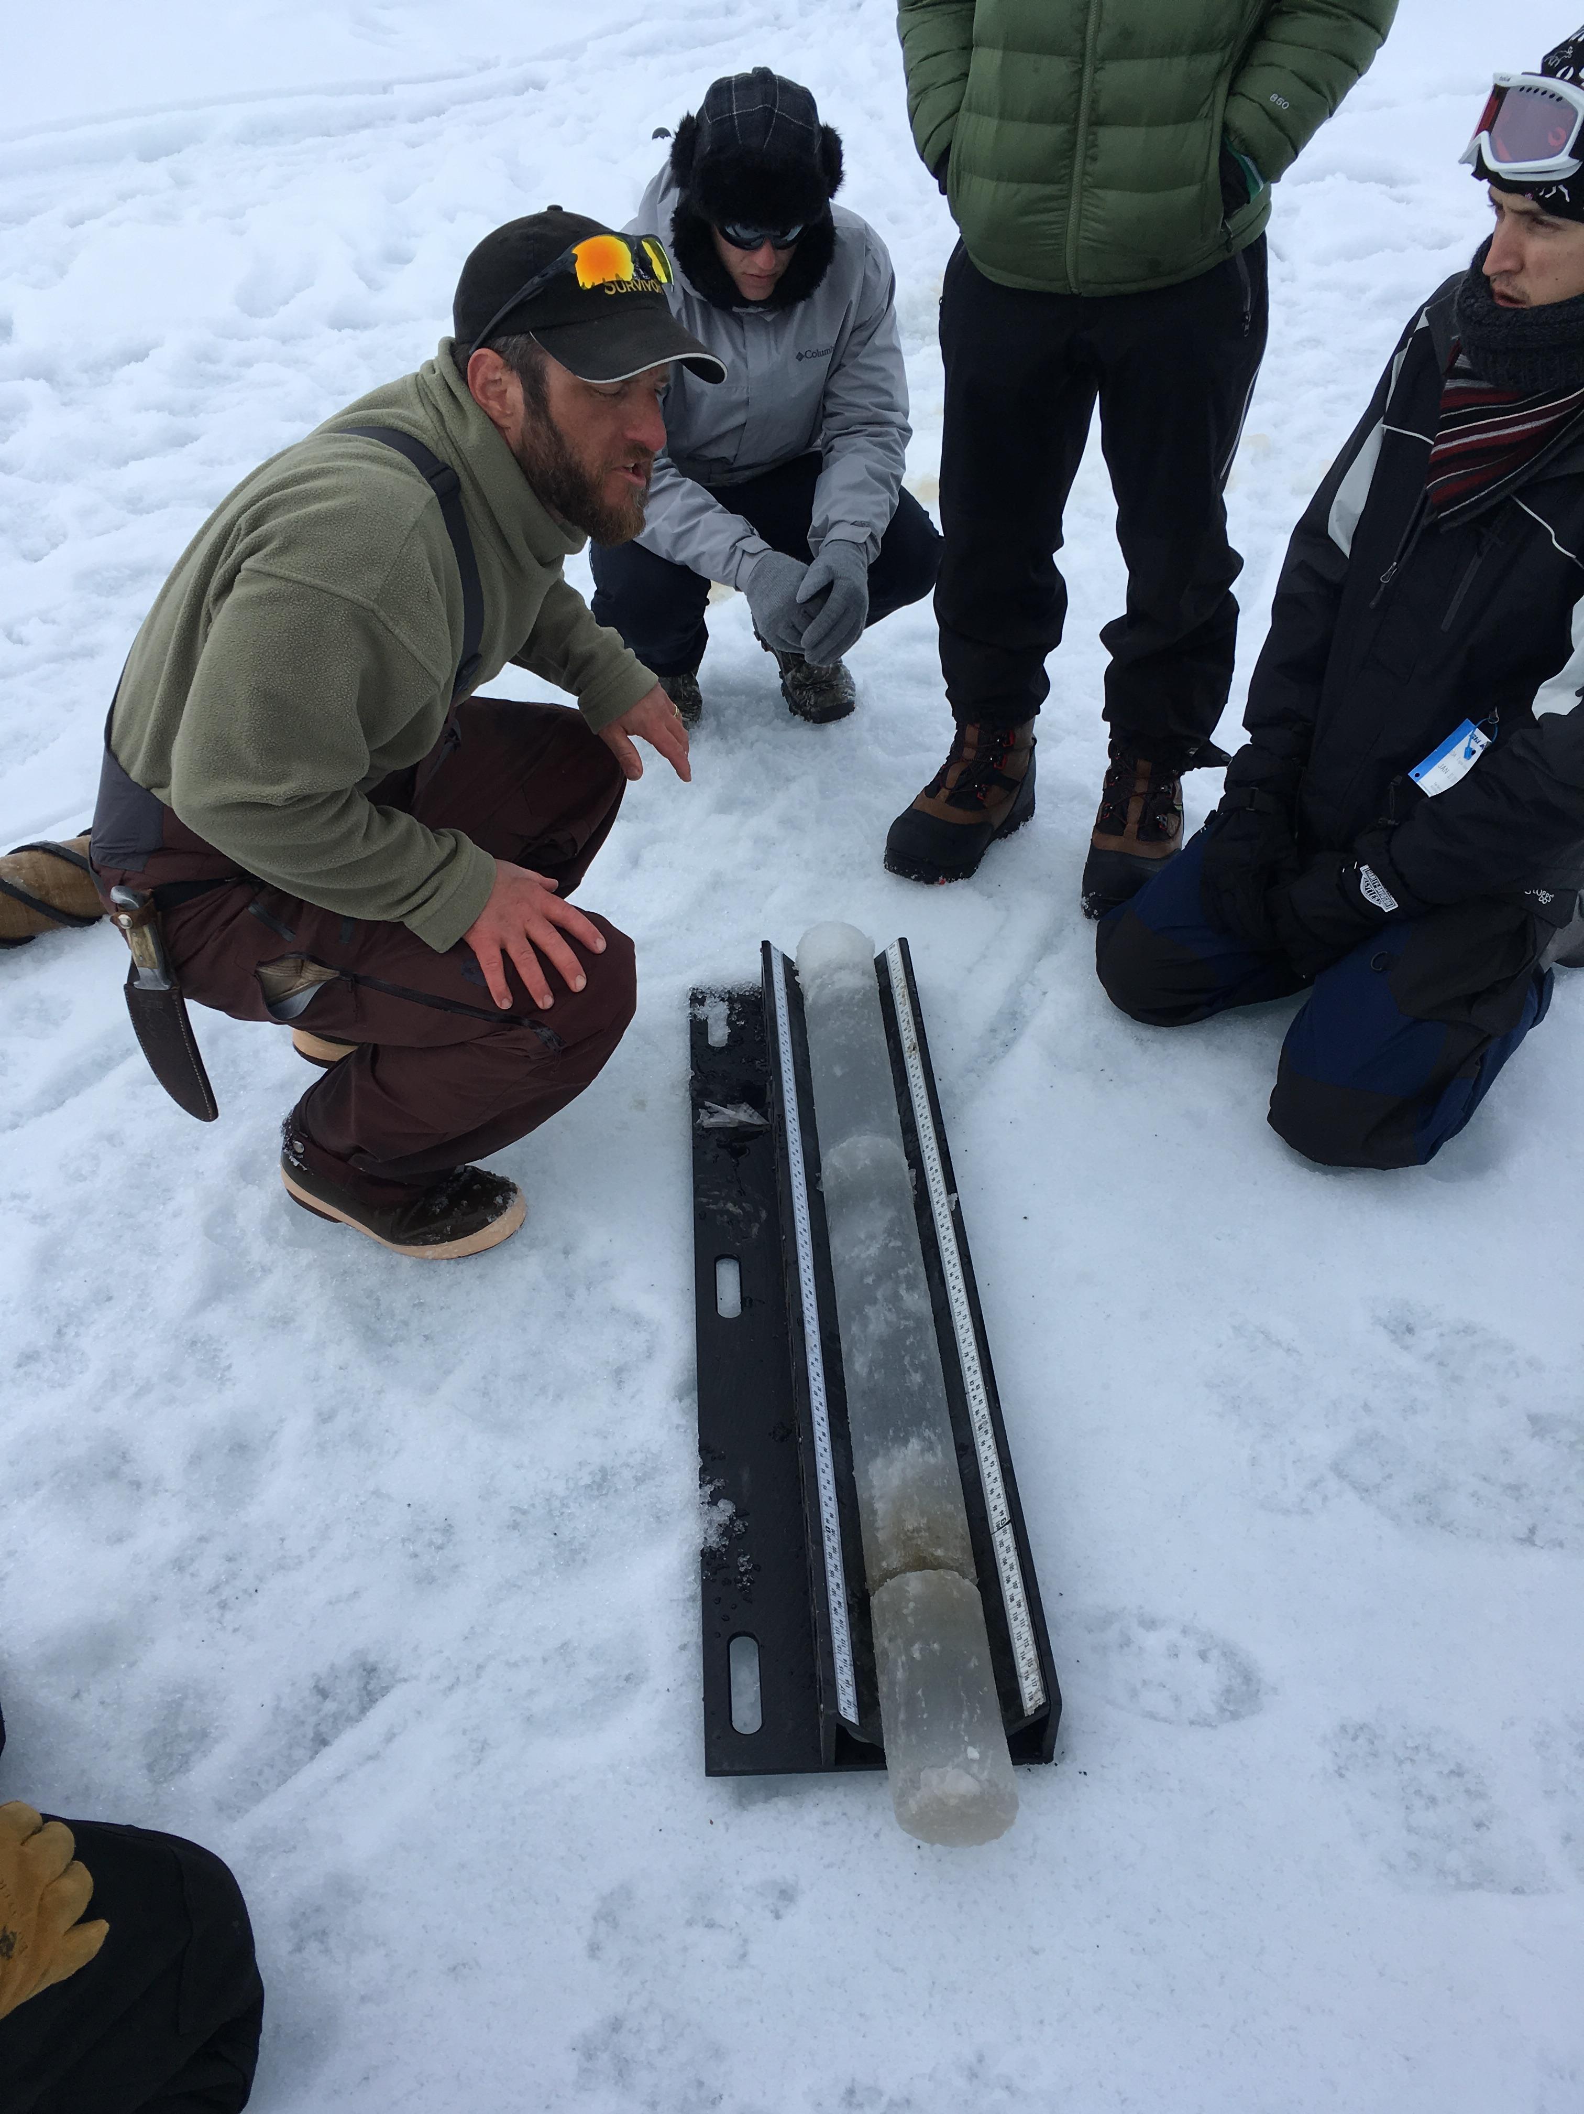
ADAC Fellowship and Arctic Summer Internship Programs
ADAC Program Year 5 Annual Meeting 11-12 April 2019
Education:
Learning form Arctic experts
in an Arctic environment
Dr. Doug Causey
Dr. Larry Hinzman
Dr. Craig Tweedie
Dr. Andy Mahoney

Slide 24
ADAC Fellowship and Arctic Summer Internship Programs
ADAC Program Year 5 Annual Meeting 11-12 April 2019
Leadership:
Providing mentorship, and leading by example
Maj Ge Randy “Church” Kee
Ms. Elizabeth Matthews

Slide 25
ADAC Fellowship and Arctic Summer Internship Programs
ADAC Program Year 5 Annual Meeting 11-12 April 2019
Looking to the Future:
The way forward:
- Helping students with the next step in their academic and professional careers.
My experience with ADAC has led me directly to where I want to be:
- Graduation this summer
- UAS Masters of Teaching Program
- Teaching in rural Alaska
- Building Arctic security through resilient communities

Slide 26
ADAC Program Year 5 Annual Meeting
“ADAC’s Arctic Summer Internship”
ADAC Fellow, Michael Wegner, USNA

Slide 27
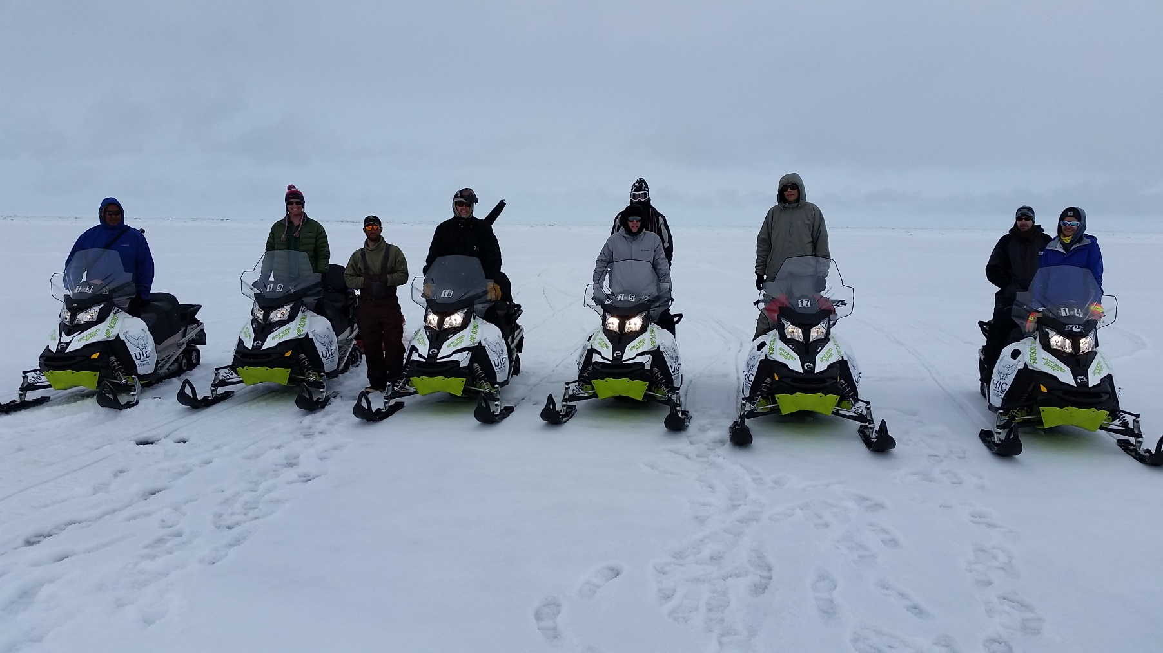
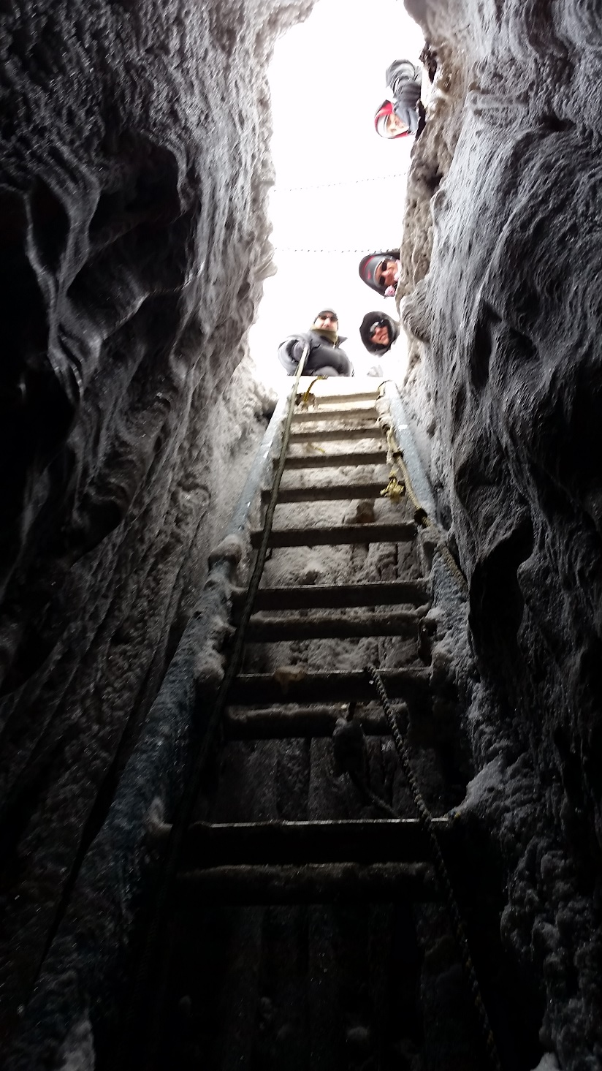
ADAC Program Year 5 Annual Meeting 11-12 April 2019
Arctic Summer Internship Program (ISIP) Reflection

Slide 28
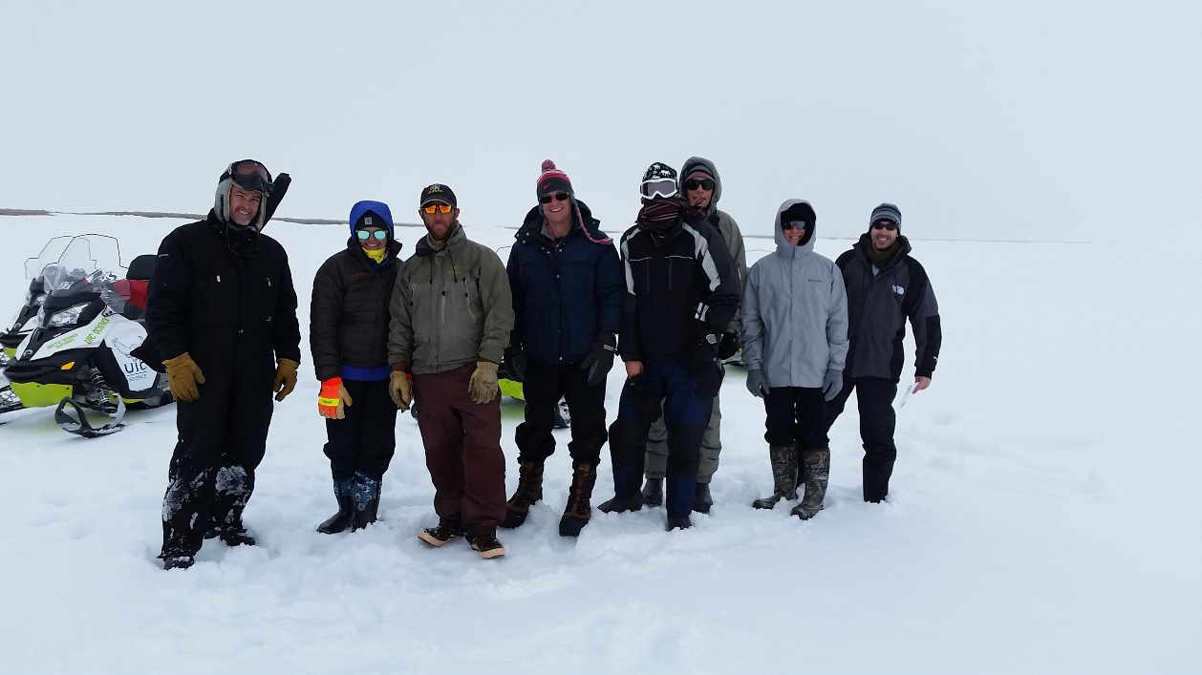
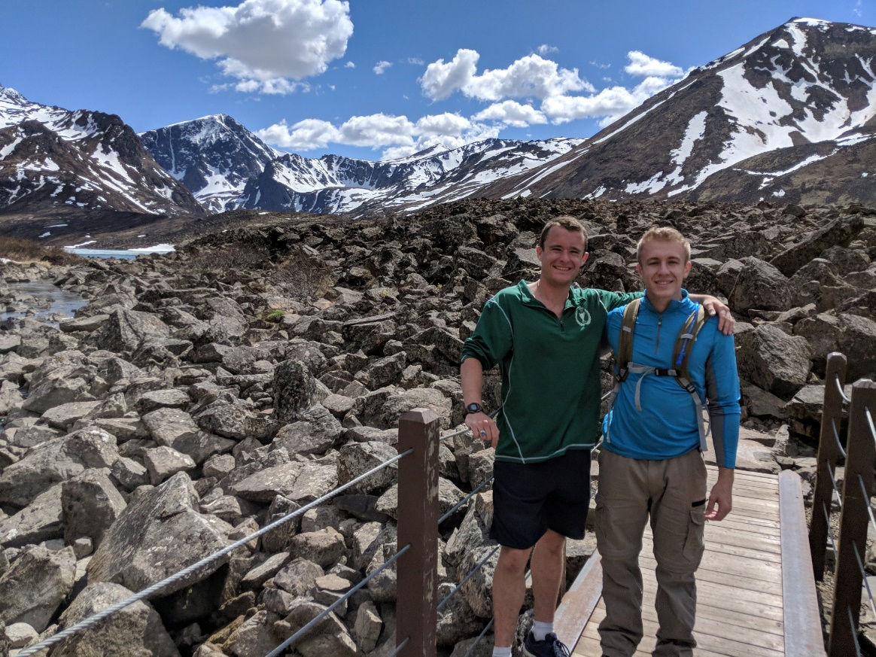
ADAC Program Year 5 Annual Meeting 11-12 April 2019
What I learned:
Changing Arctic, our lifetime.
Central to National Security.
Amazing science.
Hard-working, passionate people.

Slide 29
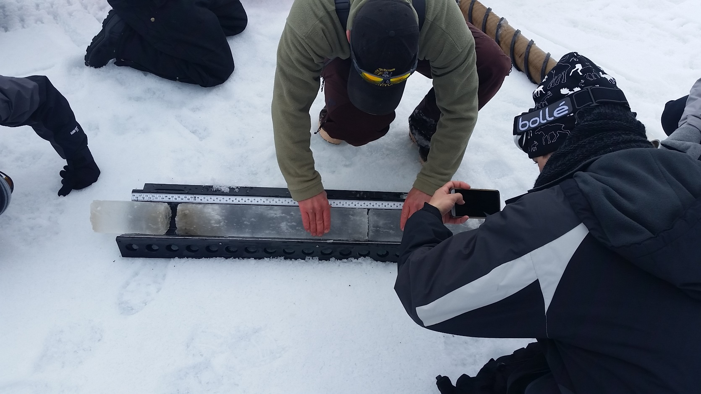
ADAC Program Year 5 Annual Meeting 11-12 April 2019
Our futures:
Each of us in ASIP have unique passions and life paths.
  I will be a SWO(nuclear) officer, my first ship in Spain.
  The Arctic matters, even in the Med! Global connection.

Slide 30
ADAC Program Year 5 Annual Meeting
“ADAC’s Arctic Summer Internship”
ADAC Fellow, Ethan Blough, Tiffin University

Slide 31
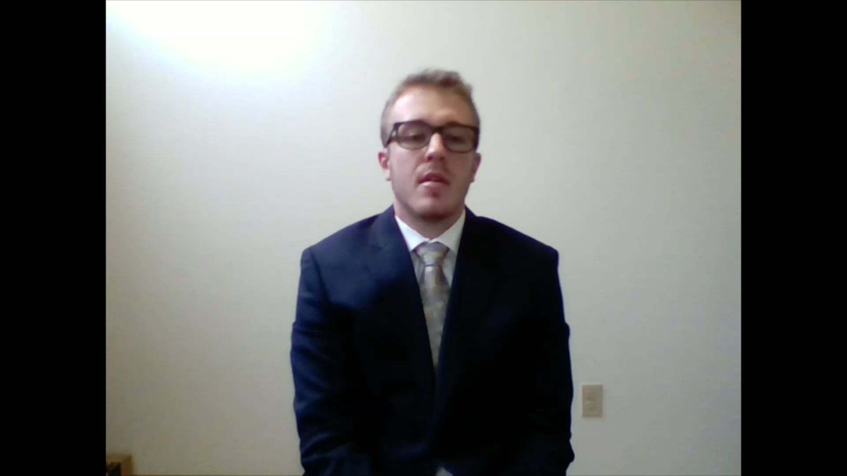
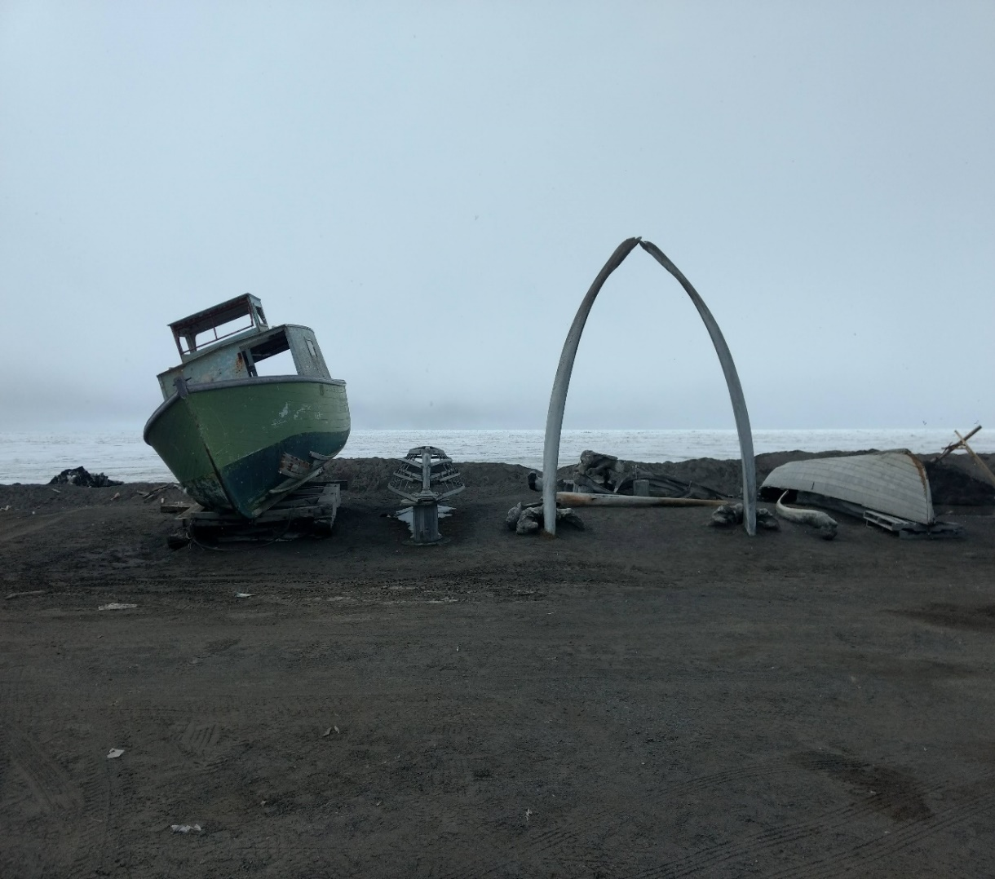
ADAC Program Year 5 Annual Meeting 11-12 April 2019
Arctic Summer Internship Program (ASIP) Reflection
Intellectual Diversity of ASIP Participants
Discussion Groups and Arctic Experts
Cultural Exploration
Overall takeaway from the ASIP experience
How ASIP changed my educational future

Slide 32
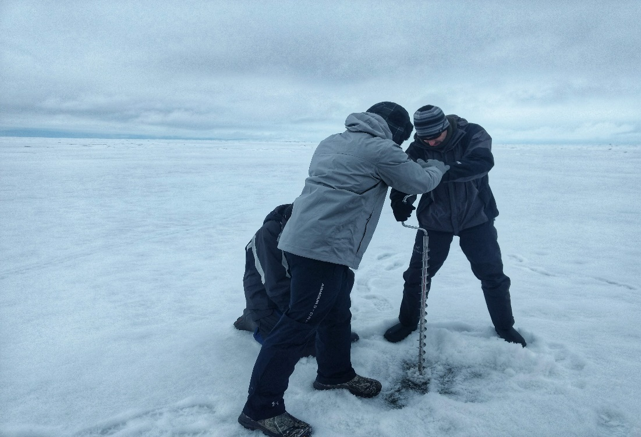
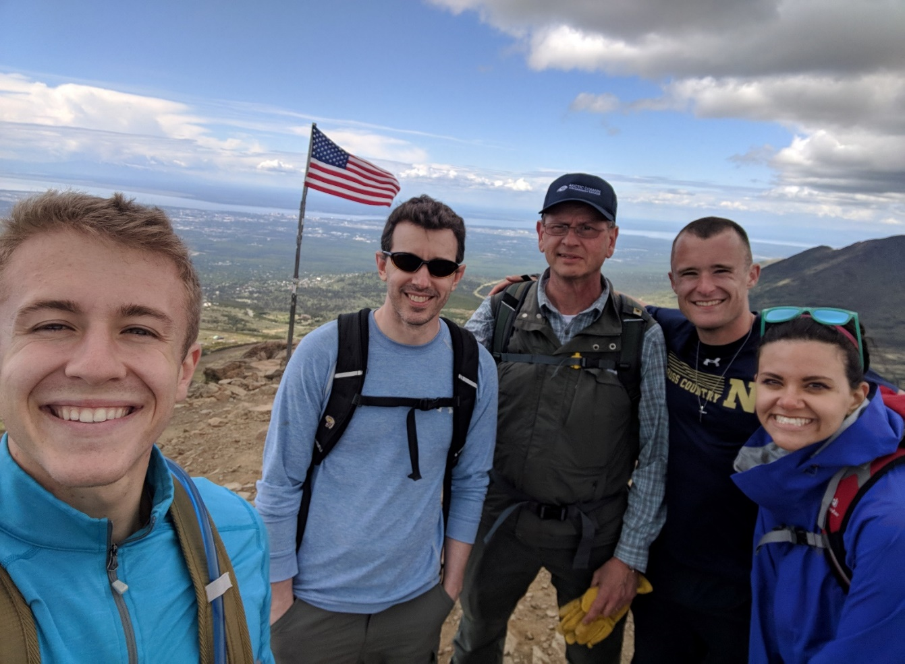
Intellectual Diversity of ASIP Participants
ADAC Program Year 5 Annual Meeting 11-12 April 2019
We all have diverse backgrounds and education
A unique opportunity to learn
Overcoming challenges

Slide 33
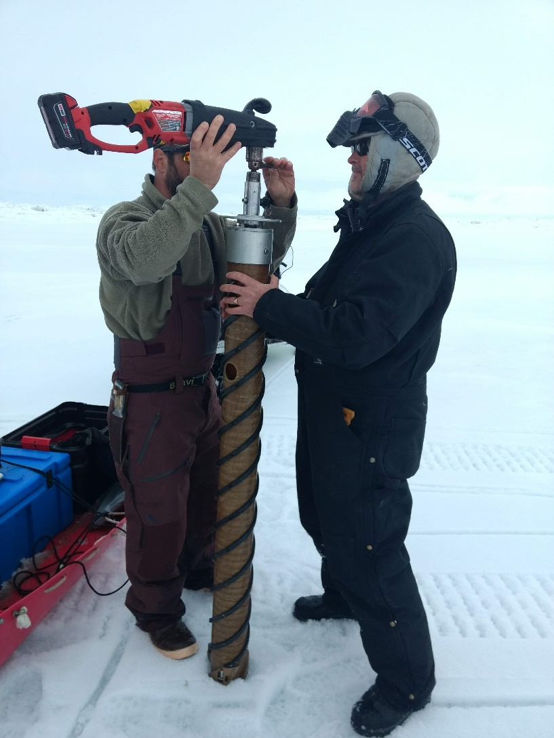
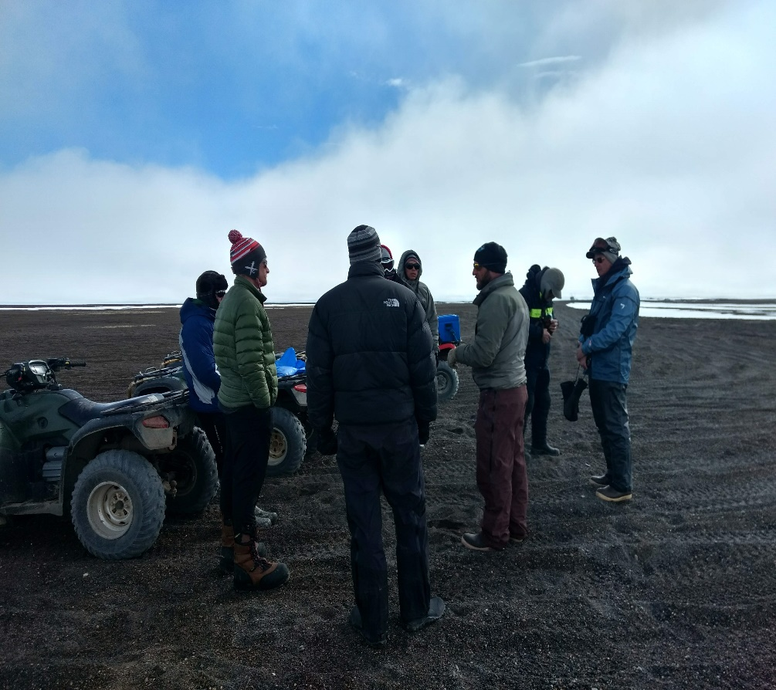
Discussion Groups and Arctic Experts
ADAC Program Year 5 Annual Meeting 11-12 April 2019
Challenging problems with unique solutions
Crucial learning opportunity as fellows
A fantastic opportunity to collaborate

Slide 34
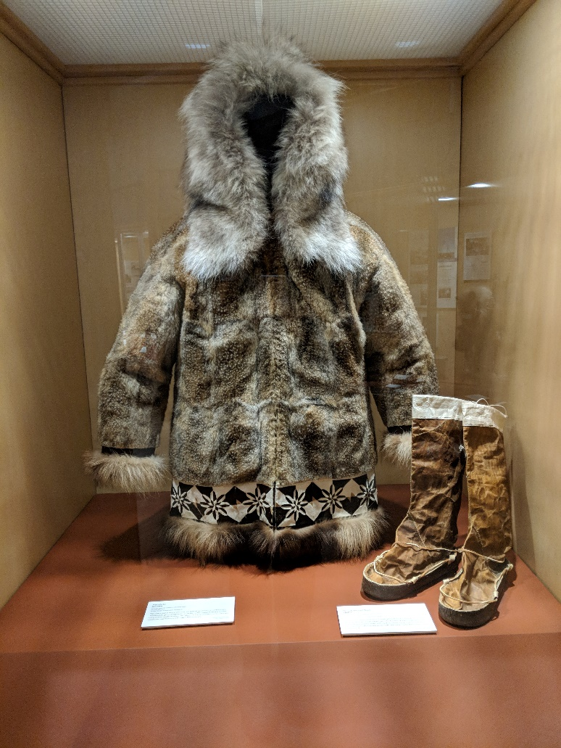
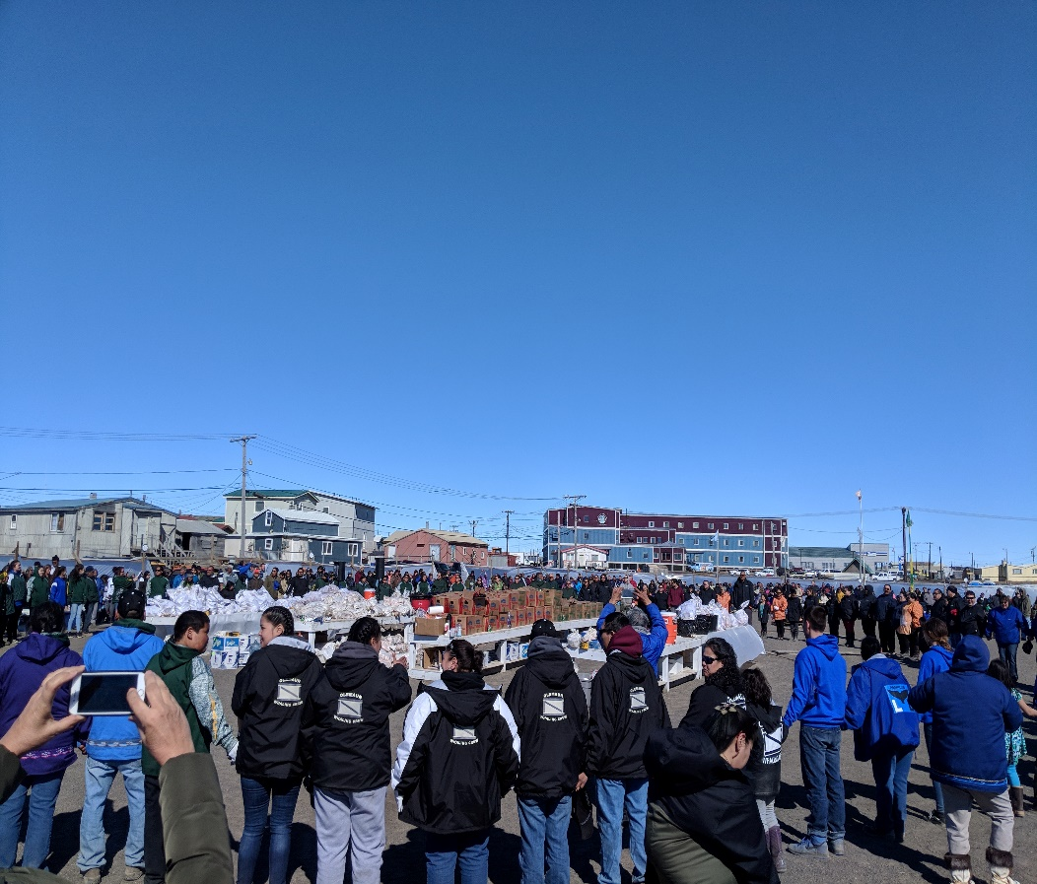
Cultural Exploration
ADAC Program Year 5 Annual Meeting 11-12 April 2019
Visiting Heritage centers
Meeting with local officials
Observing Naluqatak
Why this is beneficial

Slide 35
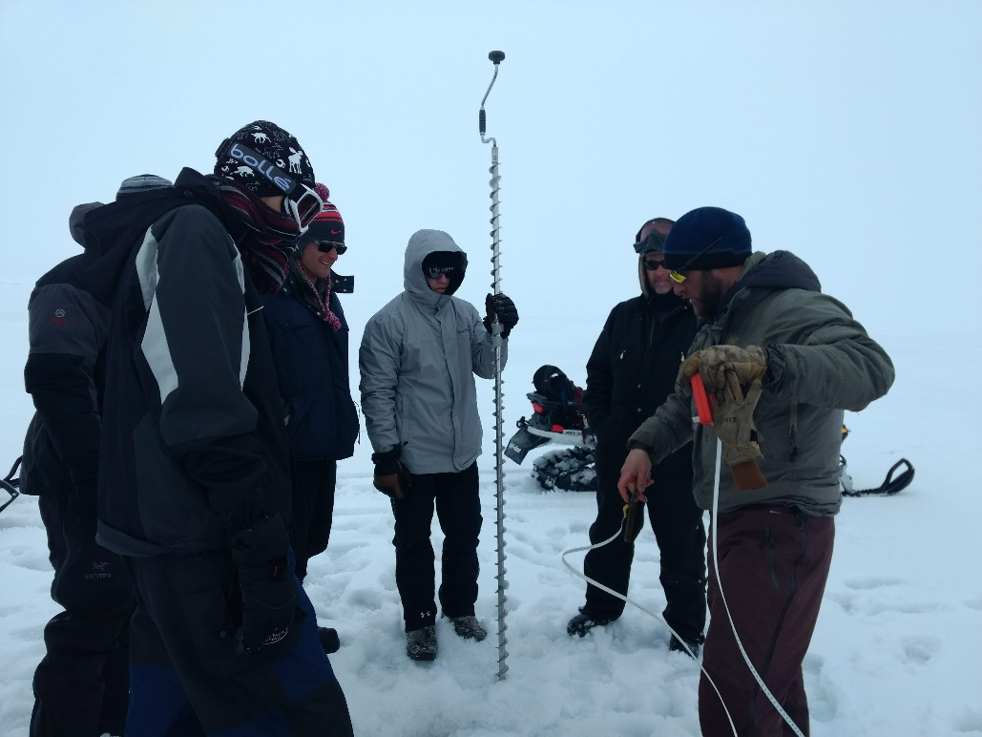
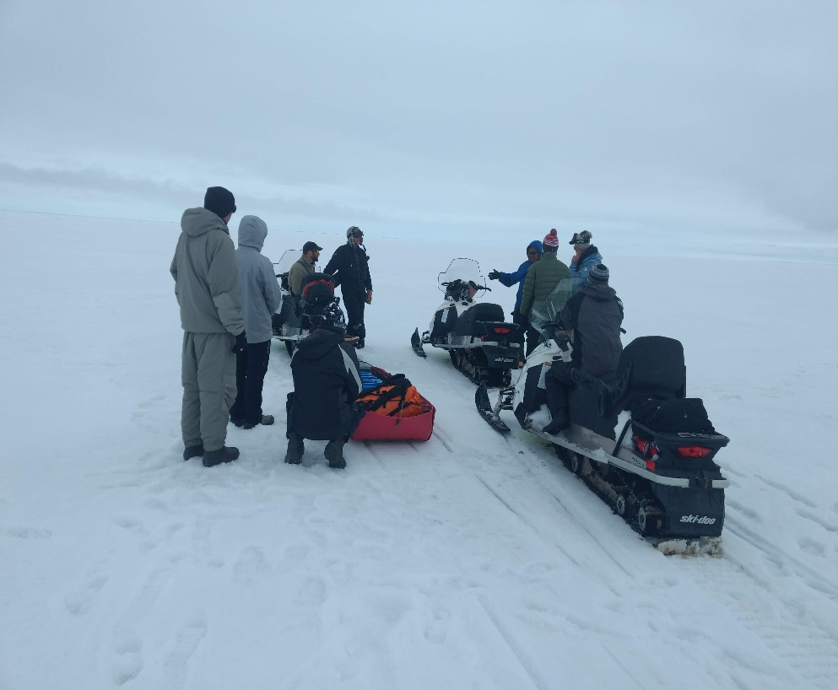
Overall Takeaway from the ASIP
ADAC Program Year 5 Annual Meeting 11-12 April 2019
Indispensable first-hand experience
Allowed us to explore how to address problems facing the Arctic
Including local people is very important

Slide 36
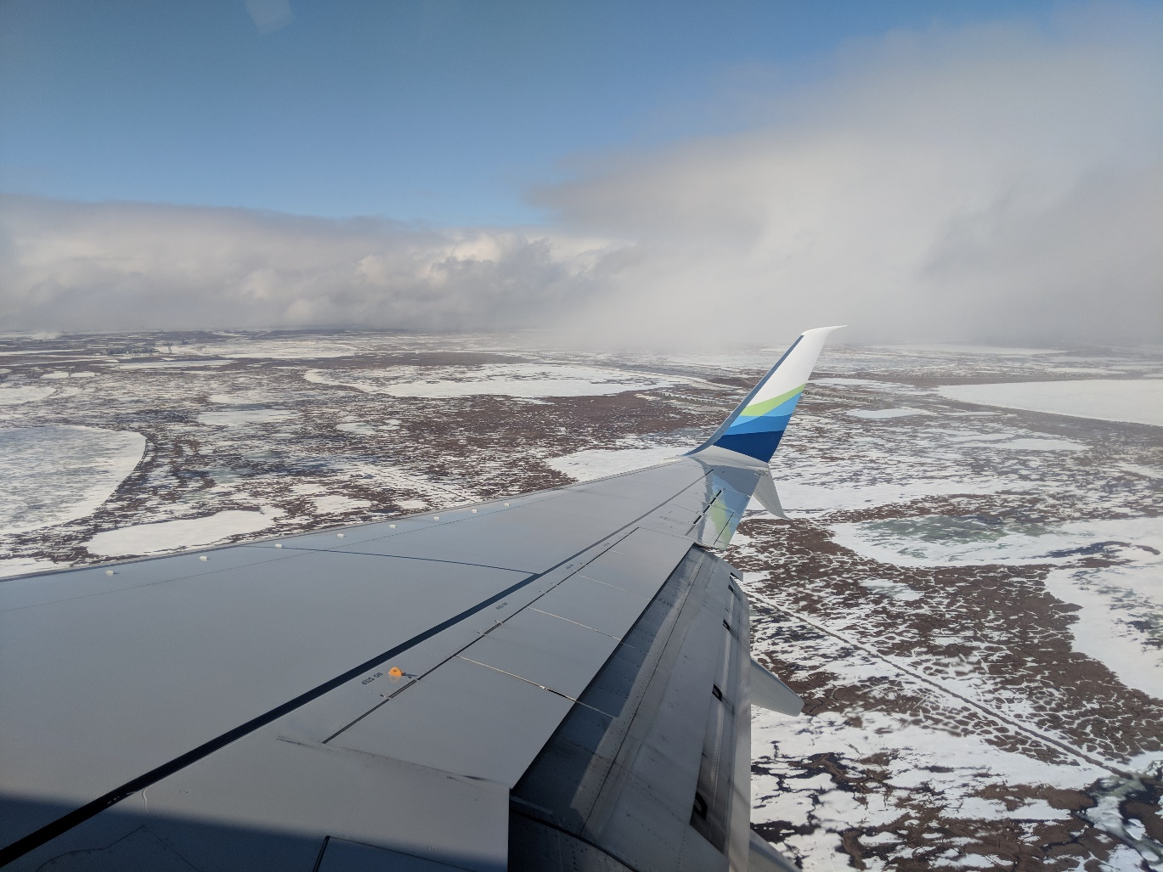
How ASIP Changed my Educational Future
ADAC Program Year 5 Annual Meeting 11-12 April 2019
I began the ASIP set on environmental law or oceanography, however this changed as the internship progressed
How exercise physiology can help the Arctic Operator
Continuing my education

Slide 37
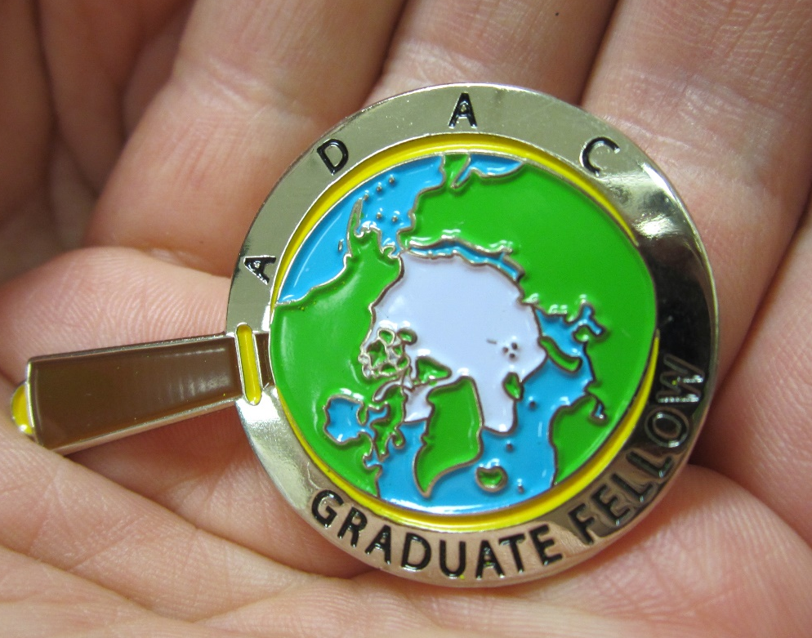
Ready for questions
Feedback…
What are we missing?
What can we improve?
Who should we connect with to improve odds of program success?
Notes:
Thank you for the gift of your time and attention.

